Slide 1
Social Exchange Theory
Rafiq Sarkar
Knowledge Management
Registration # 1506895
Sher-E-Bangla Agricultural University
rafiqsarkar@matrix-bds.com

Slide 2
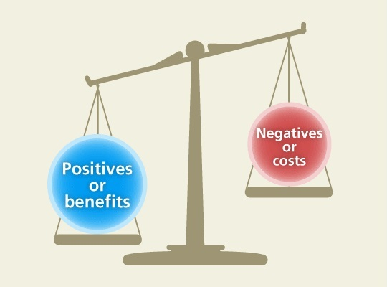
Definition
Social exchange theory is a social-psychological and sociological perspective that explains social change and stability as a process of negotiated exchanges between parties
Social exchange theory posits that human relationships are formed by the use of a subjective cost-benefit analysis and the comparison of alternatives. The theory has roots in economics, psychology and sociology

Slide 3
General Assumptions
If people define situations as real, they will be real in their consequences.
Social facts do not have any inherent meaning other than that which humans attribute to them.
Social exchange theory suggests that we essentially take the benefits and minus the costs in order to determine how much a relationship is worth. Positive relationships are those in which the benefits outweigh the costs, while negative relationships occur when the costs are greater than the benefit
social exchange as the exchange of activity, tangible or intangible, and more or less rewarding or costly, between at least two persons – George Homan – 1958
All behaviour is a series of exchanges. Individuals want to maximise rewards and minimise costs.
If a relationship is to be successful then both parties are expected to give and take in equal proportions.

Slide 4
History
Social exchange theory was introduced in 1958 by the sociologist George Homans with the publication of his work "Social Behavior as Exchange“
After Homans founded the theory, other theorists continued to write about it, particularly Peter M. Blau and Richard M. Emerson, who in addition to Homans are generally thought of as the major developers of the exchange perspective within sociology
Peter Blau - social exchange theory more towards the economic and utilitarian perspective, whereas Homans focused on reinforcement principles which presuppose individuals base their next social move on past experiences.
Blau felt that if individuals focused too much on the psychological concepts within the theory, they would refrain from learning the developing aspects of social exchange

Slide 5
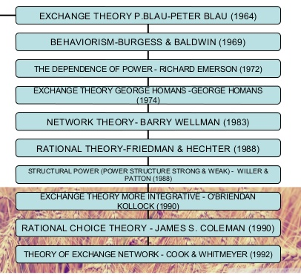
Social exchange theory was introduced in 1958 by the sociologist George Homans with the publication of his work "Social Behavior as Exchange“

Slide 6
Self-interest and Interdependence
Self-interest and interdependence are central properties of social exchange
Homans uses the concepts of individualism to explain exchange processes. To him, the meaning of individual self-interest is a combination of economic and psychological needs
Fulfilling self-interest is often common within the economic realm of the social exchange theory where competition and greed can be common
In social exchange, self-interest is not a negative thing; rather, when self-interest is recognized, it will act as the guiding force of interpersonal relationships for the advancement of both parties’ self-interest" — Michael Roloff (1981)

Slide 7
Basic concepts
Exchange as a social behavior that may result in both economic and social outcomes
Generally analyzed by comparing human interactions with the marketplace
Every individual is trying to maximize his wins. Once this concept is understood, it is possible to observe social exchanges everywhere, not only in market relations, but also in other social relations like friendship.
The process brings satisfaction when people receive fair returns for their expenditures. The major difference between social and economic exchange is the nature of the exchange between parties. Neoclassic economic theory views the actor as dealing not with another actor but with a market and environmental parameters, such as market price
Social exchanges involve a connection with another person; involve trust and not legal obligations; are more flexible; and rarely involve explicit bargaining

Slide 8
Cost and rewards
social exchange models assume that rewards and costs drive relationship decisions
Both parties in a social exchange take responsibility for one another and depend on each other. The elements of relational life include:
Costs are the elements of relational life that have negative value to a person, such as the effort put into a relationship and the negatives of a partner- (Costs can be time, money, effort etc.)
Rewards are the elements of a relationship that have positive value. (Rewards can be sense of acceptance, support, and companionship etc.)
Worth = Rewards – Costs
If worth is a positive number, it is a positive relationship, a negative number indicates a negative relationship

Slide 9
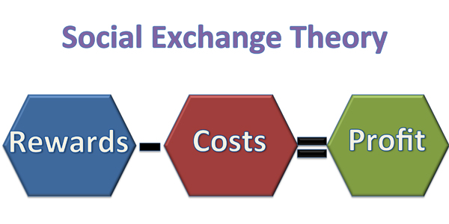
Positive relationships are expected to endure, whereas negative relationships will probably terminate. Mutual relationship satisfaction ensures relationship stability
Outcome = Rewards – Costs

Slide 10
Human Behavior
The Five Propositions of All Human Behavior
The Success Proposition: If an activity was previously rewarded, then the individual is more likely to repeat the activity again.
The Stimulus Proposition: Principle of experience. If a similar stimulus presents itself and resembles an originally awarded activity, the individual is likely to repeat that course of action.
The Value Proposition: Principle of value of outcome. The more valuable to an individual a unit of the activity another gives him/her, the more often he/she will emit the activity rewarded by the activity of the other. (watching football)
The Deprivation-Satiation Proposition: Principle of diminishing returns. Someone who goes a long time without a desired reward becomes far more willing to engage in behavior that will lead to desired reward. (Being away from loved ones)
The Aggression-Approval Proposition: When a behavior does not receive expected reward, the response is anger or aggression. (Students grades)

Slide 11
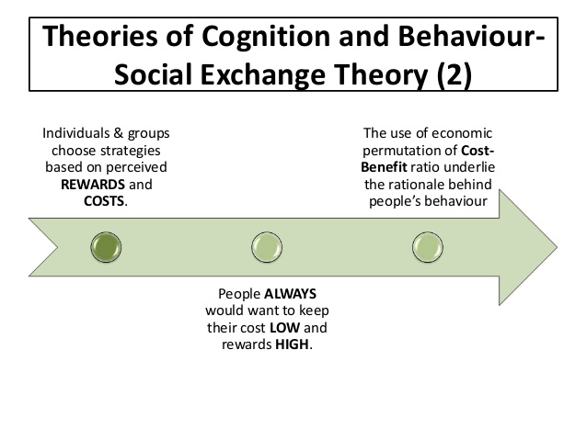
The Group System
Elements
Activity: What the members of a group do as members.
Interaction: Relation of the activity of one member of the group to that of another.
Sentiment: The sum of the feelings of group members with respect to the group.
Norms: Code of behavior adopted consciously or unconsciously by the group.

Slide 12
Power and Authority
Homans felt that a person who influences other members has authority.
An individual earns authority by acquiring esteem and acquires esteem by rewarding others.
Power can be defined as the ability to provide valuable rewards.
When directing others, the leader inevitably causes the members to incur costs. The leader’s incurring costs will help prevent conflict.
Example: If employees are asked to work late, they will be less upset if the boss also stays and works late.

Slide 13
Elements of Social Exchange Theory Thibaut & Kelley (1959) & Homans (1961)
Perceived profit = rewards – costs (pp=r-c)
We are all in relationships for profit.
We leave relationships when we no longer perceive them as profitable or when the costs of staying outweigh the rewards.
Self-interest (WIIFM)
Seek fair outcomes, distributive justice, and equity
Alter own behavior or seek to alter others’ behavior to achieve desired outcomes
Exchange of resources via transactions

Slide 14
Perceived Profit
What individuals perceive they are profiting by being in the relationship (may or may not be “reality”)
Different and unique for each person
Can be extremely high or close to no profit
As long as both parties view the relationship as profitable, the relationship can endure.

Slide 15
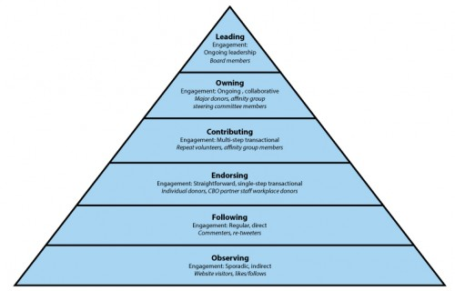
Rewards
What we give each other in relationships
What things do you get out of your relationships that you highly value?
Types of Reward
Cash
Goods
Services
Sentiments

Slide 16
Reward Problematics
Reward Deprivation – occurs when there is a type of reward one “perceives” a great need for but are not getting (and literally crave that reward). An individual may even leave the relationship and/or cheat to get what they perceive they need.
Reward Satiation – occurs when one receives “too much of a good thing” and a particular reward comes to have little value, even if it was once important.

Slide 17
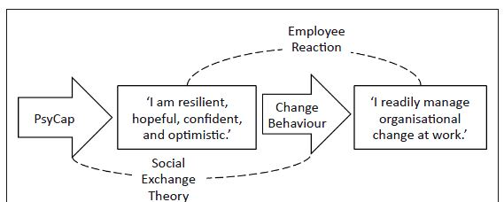
Costs
Inherent (actual) – time, money, energy
Psychological – stress of giving the reward
Rewards Foregone – what one gives up in order to give another a reward

Slide 18
Principles of Social Exchange Theory
Principle of Reward
The more often a particular action of a person is rewarded, the more likely the person is to perform that action
Principle of Experience
If an individual’s action has been rewarded in the past, then the individual will enact the same action in circumstances similar to the one in which the previous action was rewarded
Principle of Value of Outcome
The more a person values the result of an action, the more likely s/he is to perform that action.

Slide 19
Principle of Diminishing Returns
The more often in the recent past a person has received a particular reward, the less valuable any further unit of that becomes.
Reward Satiation
Principle of Distributive Justice
When an action does not produce an expected reward, or causes unexpected punishment, a person will feel cheated and is likely to engage in punitive actions.
When an action produces an unexpected reward, or when it does not produce expected punishment, a person ingratiated or obligated will likely engage in approving behavior

Slide 20
Principle of Rationality
ln any decision situation, a person will choose that action for which, as perceived by him/her at the time, the value of the result multiplied by the probability of getting the result, is the greatest.
Principle of Least Interest
The person who has the least interest in continuing the relationship is able to control the relationship and exploit the other partner.
In studying college dating: Men ⇒ financial & emotional investment for physical affection Women ⇒ sexual investment to gain attention and commitment

Slide 21
Achieving Balance
Individuals will often endure what seems like extreme costs if they perceive future payoffs.
Individuals seek to create ultimate exchanges in which both people feel they are profiting highly but experiencing little, if any, costs.
Obligation can occur when exchanges are uneven and a sense of indebtedness is created.
When couples struggle, it is seldom simply over who does what. Far more often, it is over the giving and receiving of gratitude (Hochschild, 1989).

Slide 22
Homans's theoretical propositions
an individualistic approach, a major goal of his work was to explicate the micro-foundations of social structures and social exchange.
social structures emerge from elementary forms of behavior
The first proposition: the Success Proposition states that behavior that creates positive outcomes is likely to be repeated
The second proposition: the Stimulus Proposition believes that if an individual's behavior is rewarded in the past, the individual will continue the previous behavior
The third proposition: the Value proposition believes that if the result of a behavioral action is considered valuable to the individual, it is more likely for that behavior to occur
The fourth proposition: the Deprivation-satiation proposition believes that if an individual has received the same reward several times, the value of that reward will diminish.
The fifth proposition: discusses when emotions occur due to different reward situations. Those who receive more than they expect or do not receive anticipated punishment will be happy and will behave approvingly

Slide 24
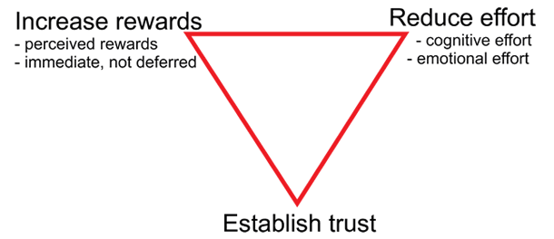
Modes of exchange
"It must be oriented towards ends that can only be achieved through interaction with other persons, and it must seek to adapt means to further the achievement of these ends“
mutual reinforcement by two parties of each other's actions
The process begins when at least one participant makes a “move,” and if the other reciprocates, new rounds of exchange initiate. Once the process is in motion, each consequence can create a self-reinforcing cycle.
Norms, beliefs, interest to exchange and receipt

Slide 25
Critiques
The theory reduces human interaction to a purely rational process that arises from economic theory.
The theory favors - when ideas of freedom and openness were preferred, but there may be times when openness isn’t the best option in a relationship.
The theory assumes that the ultimate goal of a relationship is intimacy when this might not always be the case.
The theory places relationships in a linear structure, when some relationships might skip steps or go backwards in terms of intimacy

Slide 26
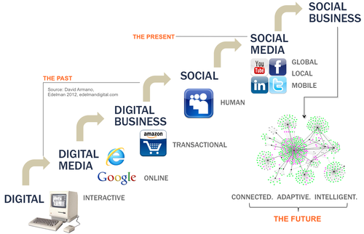
Examples of Implication

