Slide 1
Social capital theory Quazi Afzal Hossain PHD FELLOW AEIS 604 DEPT. OF AEIS SHER-E-BANGLA AGRICULTURAL UNIVERSITY

Slide 2
SOCIAL CAPITAL
.
“Social capital” appeared in a book published in 1916 USA
-how neighbours could work together to oversee schools.
Author Lyda Hanifan referred to social capital as
“those tangible assets [that] count for most in the daily lives of people: namely goodwill, fellowship, sympathy, and social intercourse among the individuals and families who make up a social unit”.
.

Slide 3
Factors for Social Capital and Social Theory
Two factors
-the networks of affiliation to which people belong (family groups, friendship ties, networks of professional colleagues and business contacts, membership of formal and informal associations and groups)
-the informal behavioural norms individuals and groups rely upon in establishing, maintaining, and using those networks.

Slide 4
Social Capital Theory
Encompasses the notion that our social
relationships are productive in nature; that is, ‘capital’.
The theory describes the
various dimensions of the complex social world that enable this capital

Slide 5
Social Capital Theory Contd…
This social capital weight is itself a function of a relationship (Rij) between the parties and the opportunity and awareness to exercise it (Dij).
The relationship between two parties i and
j may be sympathetic, neutral, or antipathetic.
The relationship along with the opportunity and awareness to exercise it becomes social capital Kij= Rij Dij

Slide 6
Evolution of Social Capital Theory
-Social capital’s intellectual history has deep and diverse roots which can be traced to the
eighteenth and nineteenth centuries (Adam and Roncevic 2003). The idea is connected with thinkers such as Putnam
-The term explains a commonly used adage: ‘it’s not what you know, it’s who you know’,

Slide 7
Evolution Contd…..
The first use of the term has been traced to Hanifan in1916 .
He used the term ‘capital’ specifically to highlight the importance of the social structure to people with a business and economics perspective.
Recognition with the writings of Bourdieu (1986), Coleman (1988) and Putnam (1993), who are considered the contemporary authors on social capital.

Slide 8
Dimensions
Social capital is multi-dimensional with each dimension contributing to the meaning of social Capital
The main dimensions are commonly seen as:
Ø Trust
Ø Rules and norms governing social action
Ø Types of social interaction
Ø Network resources
Ø Other network characteristics

Slide 9
Types
structural & cognitive and bonding & bridging
bonding is horizontal and equates to interaction between and among equals within a community
Bridging is vertical or between communities
Structural social capital facilitates mutually beneficial collective action through established roles and social networks supplemented by rules, procedures
Cognitive social capital, which includes shared norms, values, attitudes, and beliefs, predisposes people towards mutually beneficial collective action

Slide 10
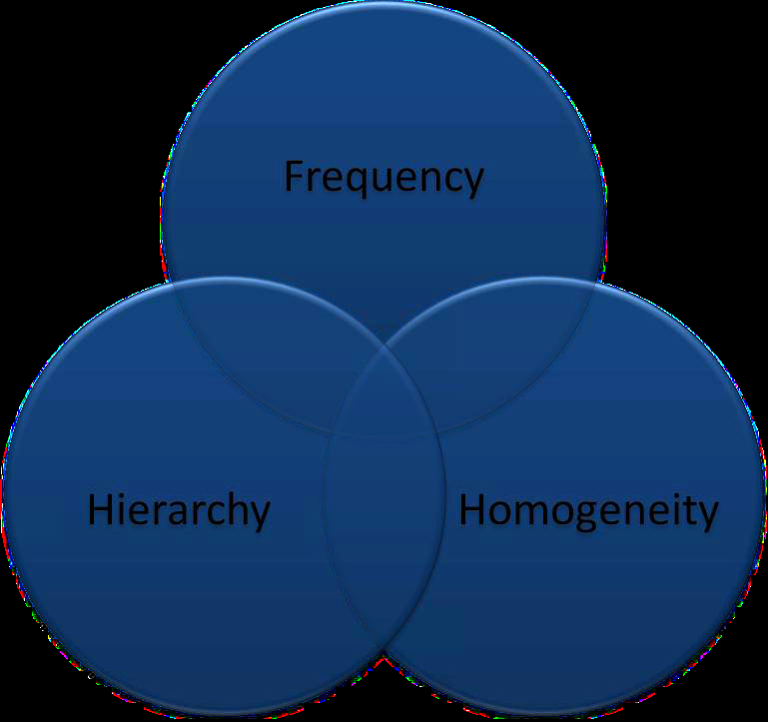
SC Dimensions & Resulting SC Types
Linking
Bridging
Bonding
Identifying

Slide 11
LEVELSs
located at the level of the individual, the informal social group, the formal organization, the community, the ethnic group and even the nation.
family, community, profession, country etc, simultaneously.
social capital’s sources lie in the social
structure within which the actor is located

Slide 12
LEVELS
Micro Individual
Meso Group
Macro Societal

Slide 13
Determinants
history and culture;
whether social structures are flat or hierarchical;
the family;
education;
the built environment;
residential mobility;
economic inequalities and social class;
the strength and characteristics of civil society; and patterns of individual
consumption and personal values.

Slide 14
Determinants Contd…
family and kinship connections;
wider social networks of associational life covers the full range of formal and informal horizontal arrangements;
networks; political society;
Institutional and policy framework which includes the formal rules and norms that regulate public life;
andsocial norms and values.

Slide 15
Benefits
An important base for cooperation across sector and power differences,
facilitation of higher levels of growth
facilitation of more efficient functioning of labor markets;
lower levels of crime;
improvements in the effectiveness of institutions of government
important variable in educational attainment, public health
Community governance, and economic problems
an important element in production , economic and business performance at both the national
and sub-national level

Slide 16
DISADVANTAGES
Potential downsides of social capital include:
fostering behavior that worsens rather than improves economic performance;
acting as a barrier to social inclusion and social mobility;
dividing rather than uniting communities or societies;

Slide 17
Conceptualization of social capital
MACRO
Institutions of the state Rule of law | Governance
Structural | Cognitive
Local Institutions Networks | Trust Local Norms and Values
MICRO

Slide 18
Four views of social capital
Perspective | Actors | Policy prescriptions
Communitarian view
Local associations | Community groups Voluntary organizations | Small is beautiful Recognize social assets of the poor
Network view
Bonding and bridging community ties | Entrepreneurs Business groups Information brokers | Decentralize Create enterprise zones Bridging social divides
Institutional view
Political and legal institutions | Private and public sectors | Grant civil and political liberties Institute transparency, accountability
Synergy view
Community networks and state-society relations | Community groups, civil society, firms, states | Coproduction, complementarily Participation, linkages Enhance capacity and scale of local organizations
(Source: Woolcock and Narayan 2000

Slide 19
Conclusion
Social capital (relationship to others) is a productive asset which is a substitute for and complement to other productive assets
The productivity of social capital leads to the expectation that firms and individuals invest in relationships.

Slide 20
Thank you very much

