Slide 1
Lecture 4 Output Devices
Md. Mahbubul Alam, PhD

Slide 2
Objectives
1
Introducing the Range of Output Devices
2
Ergonomics of Output Devices

Slide 3
Output Devices
Output devices returned processed data to the user or to another computer system.
In order to describe the range of output devices, the following categorization will be helpful:
Video output devices
Audio output devices
Printing devices

Slide 4
Video Output Devices
Monitor
Monitor is the most commonly used output device on most personal computer system.
Two important hardware devices determine the quality of the image on any monitor:
The monitor itself
The video controller
In general, three types of monitors are used with PCs
Cathode Ray Tube (CRT)
Liquid Crystal Display (LCD)
Light Emitting Diode (LED)

Slide 5
Types of Monitors by Display Colors
Monochrome monitors
Display only one color (such as green, amber, or white) against a contrasting background, which is usually black. These monitors are used for displaying texts only.
Grayscale monitors
Display varying intensities of gray (from a very light gray to black) against a white or off-white background and are essentially a type of monochrome monitor.
Color monitors
Display between 16 colors and 16 million colors.

Slide 6
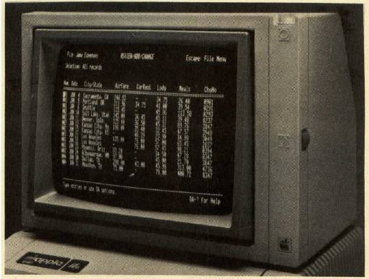
Monochrome Monitor

Slide 7
Cathode Ray Tube (CRT) Monitor
CRT monitor is the typical monitor that comes with most desktop computers; it looks a lot like a television and works in much the same way.
This type of monitor uses a large vacuum tube, called cathode ray tube.
Color CRT monitor has three electron beams which represent the primary additive colors (red. Green and blue).
Advantages: Provide a bright, clear picture at a relatively low cost.
Disadvantages: Take up desktop space and difficult to move due to the large size, require a lot of power to run.

Slide 8
Liquid Crystal Display (LCD) Monitor
Although flat-panel monitors have been used primarily on portable computers, a new generation of large, high-resolution, flat-panel displays is gaining popularity among users of desktop systems.
LCD monitor creates images with a special kind of liquid crystal that is normally transparent but becomes opaque when charged with electricity.
Two types of LCD monitors are:
Passive matrix LCD
Active matrix LCD
Advantages: Take up less desk space and run cooler than traditional CRT monitors.
Disadvantages: Images can be difficult to see in bright light, limited viewing angel.

Slide 9
Comparing Monitors
Following are the specifications which need to be taken into consideration before making purchasing decision of buying a monitor:
Specification | Description
Size | Monitors size measured diagonally in inches. Actual size is the distance from corner to corner and viewable size is the usable portion of the screen.
Resolution | Number of pixels on the screen. 640 X 480 means that there are 640 pixels horizontally and 480 pixels vertically.
Refresh Rate | The number of times per second that the electron guns scan every pixel on the screen. Good refresh rate is 72 Hertz or higher.
Dot Pitch | The distance between the like-colored phosphor dots of adjacent pixels. Dot pitch should be no greater than 0.28mm for 15-inche monitor. For larger monitors, that should be .22mm or less.

Slide 10
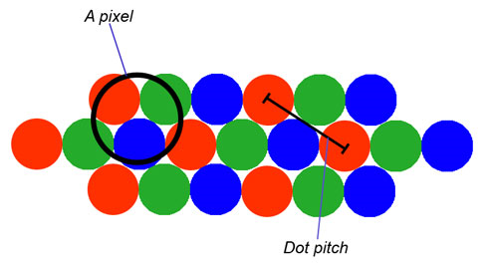
Dot Pitch

Slide 11
Video Output Devices
Video Cards
The video controller is an interface between the monitor and the CPU. The video controller determines many aspects of a monitor’s performance; for example, the video controller helps to select a resolution or set the number of colors to display.
The video controller contains its own on-board processor and memory, called video RAM.
Data Projectors
A digital light projector is a portable light projector that connects to a PC. This type of projector is rapidly replacing traditional slide projectors and overhead projectors as a means for displaying presentations.

Slide 12
Audio Output Devices
Sound cards
Sound card takes analog sound signals and digitizes them. A sound card also can convert digital sound signals to analog form.
Speaker, Headphones and Headset
These devices are used for audio output of the computer system

Slide 13
Printing Devices
Printed documents are essential in most workplaces, where people must share reports, budgets, memos and other types of information.
Besides the monitor, the other important output device is the printer.
Generally, printers fall into two categories:
Impact printers (creates an image by using pins or hammers to press an inked ribbon against the paper)
Non-impact printers (uses various other method than pins or hammers to place ink on the paper)

Slide 14
Types of Printers
Dot Matrix Printers
A dot matrix printer is an impact printer. It uses a print head that contains a cluster of pins. The printer can push the pins out in rapid sequence to form patterns. The pins are used to press an inked ribbon against paper, creating an image.
The speed of dot matrix printers is measured in characters per second.
Ink Jet Printers
An ink jet printer is an example of nonimpact printer. It creates an image by spraying tiny droplets of ink onto the paper.
Ink jet printers are inexpensive for both color and black printing, have low operating costs, and offer quality and speed comparable to low-end laser printer.
The speed of ink jet printers is measured in pages per minute. The quality is expressed as dots per inch.

Slide 15
Types of Printers
Laser Printers
Laser printers are nonimpact printers. They use heat and pressure to bond tiny particles of toner (a dry ink) to paper.
Laser printers produce higher-quality print and are fast and convenient to use, but they are also more expensive than ink jet printers.
The speed of laser printers is measured in pages per minute. The quality is expressed as dots per inch.
Other Printers
Thermal-wax and dye-sublimation printers are used primarily by print shops and publishers to create high-quality color images.
Photo printers are specialized printers used to print color photographs taken with digital cameras.
Plotters create large-format images, usually for architectural or engineering purposes, using mechanical drawing arms, ink jet technology or thermal printing technology.

Slide 16
Comparing Printers
Following are the specifications which need to be taken into consideration before making purchasing decision of buying a printer:
Specification | Description
Image Quality | Image quality, also known as print resolution, is usually measured in dots per inch (dpi). The more dpi a printer can produce, the higher its image quality.
Speed | Printer speed is measured in the number of pages per minute (ppm).
Initial Cost | Total cost of purchasing the printer.
Cost of Operation | The cost of paper, ink or toner and maintenance.

Slide 17
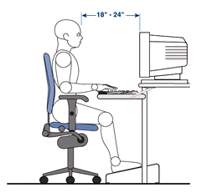
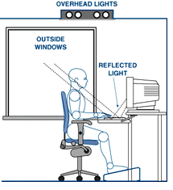
Ergonomic Techniques for Avoiding Hazards
Choose a monitor that holds a steady image without flickering
Position your monitor 2-2.5 feet away from the eyes
Place your monitor where no light reflects off the screen
Keep screen clean
Avoid looking at the monitor for more than 30 minutes without taking a break
Do not let your eyes become dry
Sit arm length away from CPU
Take frequent breaks

Slide 18
End of Chapter

