Slide 1
Lecture 3 Input Devices
Md. Mahbubul Alam, PhD

Slide 2
Objectives
1
Introducing the Range of Input Devices
2
Ergonomics of Input Devices

Slide 3
Input Devices
Input devices accept data and instructions from the user or from another computer system (such as a computer on the Internet).
In order to describe the range of input devices, the following categorization will be helpful:
Commonly used input devices
Devices for the hand
Optical input devices
Audiovisual input devices

Slide 4
Commonly Used Input Devices
The Keyboard
The keyboard was one of the first peripherals to be used with computers, and it is still the primary input device for entering text and numbers.
A standard keyboard includes about 100 keys, each key sends a different signal to the CPU.
The standard keyboard keys are arranged in five groups:
The alphanumeric keys (keys for letters and numbers)
The modifier keys (SHIFT, CTRL, ALT keys)
The numeric keypad (numeric keypad located in the right part)
The function keys (F1 to F12 keys at top)
The cursor-movement keys (Home, End, Page Up, Page Down, arrows)
Special purpose keys (Esc, Print Screen, Scroll Lock, Pause/ Break, Insert, Delete, Start, Shortcut)

Slide 5
Keyboard Layout

Slide 6
How the Computer Accepts Input from the Keyboard
1) A key is pressed on the keyboard
4) The system software responds to the interrupt by reading the scan code from the keyboard buffer
Keyboard
Keyboard
Controller
Keyboard
Buffer
System
Software
2) The keyboard controller sends the scan code for the key to the keyboard buffer
3) The keyboard controller sends an interrupt request to the system software
5) The system software passes the scan code to the CPU
C
P
U

Slide 7
Commonly Used Input Devices
The Mouse
A mouse is an input device that can move around on a flat surface (usually on a desk or keyboard tray) and control the pointer.
The pointer (also called the mouse pointer) is an on-screen object usually an arrow that is used to select text, access menus, and interact with programs, files, or data that appear on the screen.
Types:
Mechanical Mouse
Optical Mouse (nonmechanical)
Some variants of the mouse are:
Trackballs (a pointing device that works like an upside-down mouse)
Trackpads (also called touchpad, a stationary pointing device that many people find less tiring to use than a mouse or trackball)
Track points (a small joystick positioned near the middle of the keyboard)

Slide 8
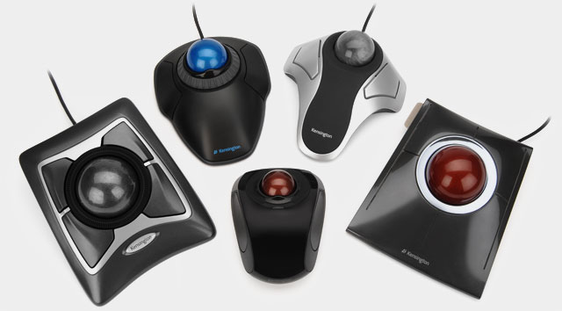
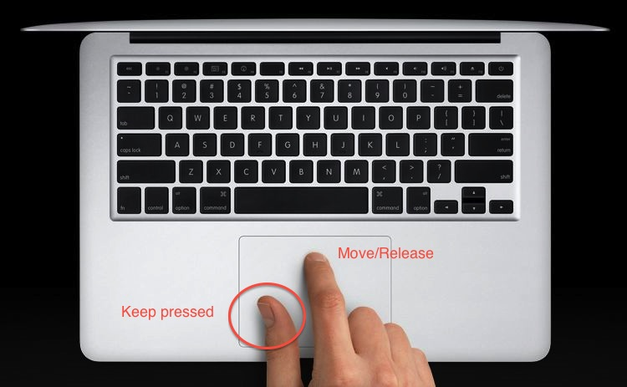
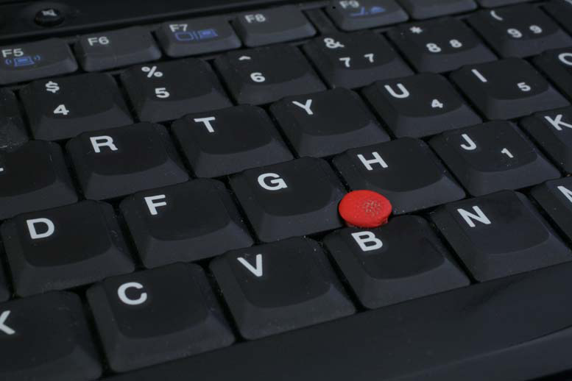
Trackball, Track pad, Track Point

Slide 9
Devices for the Hand
Pen
Pen-based systems, including many table PCs, personal digital assistants, and other type of handheld computers use a pen (often called stylus) for data input and as the pointing device to select commands or menus.
Touch Screens
Touch screens accept input by allowing the user to place a fingertip directly on the computer screen, usually to make a selection from a menu of choices.
Game Controllers
A game controller is a special input device that accepts the user’s input for playing a game. Two primary types of game controllers are joysticks and game pads.

Slide 10
Optical Input Devices
Bar Code Readers
Bar code readers, such as those used in super markets, can read bad codes, translate them into numbers, and input the numbers into a computer system.
Image Scanners
Image scanners convert printed images into digitized formats that can be stored and manipulated (most photo edit) in computers.
Optical Character Recognition (OCR)
An image scanner equipped with OCR software can translate a page of text into a string of character codes in the computer’s memory.

Slide 11
Audiovisual Input Devices
Microphones
Microphones can accept auditory input. Using speech recognition software, microphones can be used as an input device for dictating text, navigating programs, and choosing commands.
Sound cards
Sound card takes analog sound signals and digitizes them. A sound card also can convert digital sound signals to analog form.
Musical Instrument Digital Interface (MIDI)
MIDI connects many kinds of electronic musical instruments to computer.
PC video cameras and digital cameras
PC video cameras and digital cameras can digitized full-motion and still images, which can be stored and edited on the PC or transmitted over a LAN or the Internet.

Slide 12
Ergonomics
Ergonomics is the study of the physical relationship between people and their tools – such as computers – addresses these issues.
Now more than ever before, people recognize the importance of having ergonomically correct computer furniture and using proper posture and techniques while working with computers.
Ergonomically correct means that a tool or a workplace is designed to work properly with the human body, and thus reduces the risk of strain and injuries.

Slide 13
Health Hazards
Repetitive stress injury or repetitive strain injury (RSI) results from continuously using the body in ways it was not designed to work, such as pain in wrist or hand caused by using a keyboard or mouse for long period of time.
Eyestrain is fatigue of the eyes (eye muscles are stained) caused by focusing on the same point on the computer monitor for too long. It can lead to chronic headache.
Electromagnetic fields (EMFs) are created during the generation, transmission and use of low-frequency electrical power while using devices like computers and can cause cancer in long run.

Slide 14
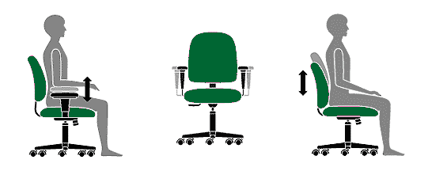
Ergonomic Techniques for Avoiding Hazards
Office chairs of offices should:
Allow you to adjust its height
Provide good lower-back support
Have adjustable armrests

Slide 15
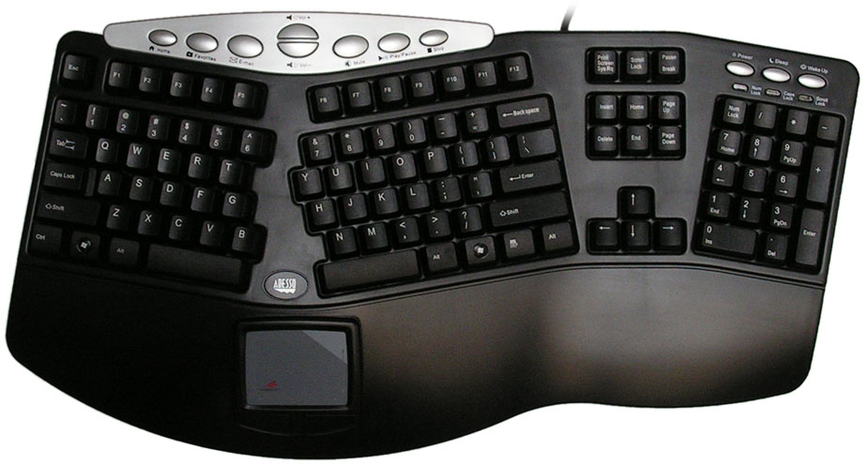
Ergonomic Techniques for Avoiding Hazards
Use an ergonomic keyboard
Use a padded wrist support
Keep your wrist straight
Sit up straight
Learn how to type quickly but safe
Take frequent breaks from typing

Slide 16
End of Chapter

