Slide 1
Lecture 5 Storage Technologies I
Md. Mahbubul Alam, PhD

Slide 2
Objectives
1
Introduce Storage Technology
2
Types of Storage Technology

Slide 3
Storage
A computer can function with only processing, memory, input, and output devices. To be really useful, a computer also needs a place to keep program files and related data when they are not in use.
The purpose of storage is to hold data permanently, even when the computer is turned off.
Novice computer users often confuse storage with memory. Although the functions of storage and memory are similar, they work in different ways.

Slide 4
Storage vs. Memory
There are three major distinctions between storage and memory:
There are more room in storage than in memory, just as there is more room in file cabinet than there is on a tabletop.
Contents are retained in storage is turned off, whereas programs or the data in memory (memory here is used to represent RAM) disappear when you shut down the computer.
Storage devices operate much slower than memory chips, and storage is much cheaper than memory.

Slide 5
Storing Process
The purpose of a storage device is to hold data, even when the computer is turned off, so the data can be used whenever it is needed.
Storage involves two processes:
Writing or recording the data so it can be found later for use.
Reading the stored data, then transferring it into the computer’s memory.

Slide 6
Storage Media and Storage Device
The physical materials on which data is stored are called storage media.
The hardware components that write data to, and read data from storage media are called storage devices.
For example, Compact Disk (CD) is a storage media and CD ROM Drive is a storage device.

Slide 7
Clarifying the Concepts
Data is written/ recorded in:
Storage media
Data is written/ recorded by:
Storage device
Data is read from:
Storage media
Data is read by:
Storage device

Slide 8
Categories of storage technology
Magnetic Storage
Magnetic storage devices work by polarizing tiny pieces of iron on the magnetic medium.
Read/ write heads contain electromagnets that create magnetic charges on the medium.
Optical Storage
Optical devices store data on a reflective surface so it can be read by a beam of laser light.
Solid-state Storage
More commonly found in devices such as digital cameras and media-players.

Slide 9
Magnetic Storage
The surfaces of magnetic storages are coated with a magnetically sensitive materials, such as iron oxide that reacts to a magnetic field.
Magnetic field is used for storing the data on the media surface.
The surfaces of magnetic disk and tapes are coated with millions of tiny iron particles so that data can be stored on them.
The read/ write heads of a magnetic disk drive contain electromagnets that generate magnetic fields in the iron on the storage medium as the head passes over the disk.

Slide 10
How data is stored on a disk?

Slide 11
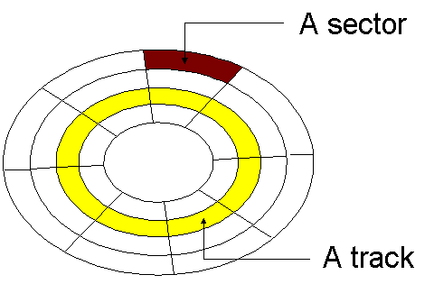
How data is organized on a magnetic disk?
Disks must be formatted before use
The process of mapping a disks surface is called formatting or initializing
Format draws tracks (concentric circles) on the disk.
Tracks are divided into sectors (where data is physically
stored on the disk).
Each track and sector is labeled with numbers.
Data is organized in clusters.
In all diskettes and most hard disks, a sector can store up to 512 bytes (0.5 KB).
Most diskettes have 80 tracks on each side of the disk, where a hard disk may have several hundred tracks on each side of each platter.

Slide 12
Problem
If one standard floppy disk has 18 sectors on each tracks, then what will be the total capacity of the disk?

Slide 13
Solution
One standard diskette has 80 tracks on each side, so 160 tracks in both sides
Total Number of Sectors
= Total Tracks X Number of Sectors on Each Track
= 160 X 18 = 2,880
A sector usually can store up to 512 bytes
So, total storing capacity
= 512 bytes X 2,880 sectors
= 1,474,560 bytes (approx. 1.41 Megabytes)

Slide 14
How the operating system finds data on a disk?
Each track and each sector on a disk are labeled and the location of all data is kept in a special log.
The labeling of tracks and sectors is called logical formatting.
A logical method for managing the storage of data on a disk’s surface.
Different operating systems can format disks in different ways.
A commonly used logical format performed by windows in called the FAT file system
relies on a standardized file allocation table (FAT) to keep track of file locations on the disk.

Slide 15
File System
In computing, a file system is used to control how data is stored and retrieved.
Different operating systems use different file system
File Allocation Table (FAT), this file systems also known as FAT16 was used for MS-DOS and was the basis for the early Windows.
FAT32, extended edition of FAT16 which was used for Windows 95, Windows 2000 and Windows XP.
New Technology File System (NTFS), introduced with Windows NT and the basis for later operating systems.
NTFS 5, updated version of NTFS is used in Windows 2000 and XP.
High-Performance File System (HPFS), designed for use with IBM’s OS/2.
Resilient File System (ReFS), introduced with Windows Server 2012.

Slide 16
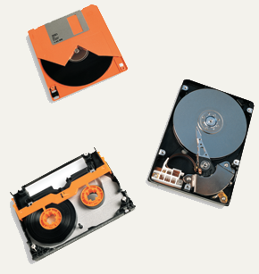
Types of Magnetic Storage
Commonly we have three types of magnetic storage:
Diskette / Floppy Disk
Hard Disk
Tape

Slide 17
Diskettes
Contain a single thin disk, usually made of plastic
This disk is flexible, that is why diskettes are often called floppy disks
A diskette stores data on both sides of its disk (numbered as side 0 and side 1)
Each side has its own read/write head
Spin at 300 RPM (revolution per minute)
Takes .2 second to find data
3 ½ inches floppy disk holds 1.44 MB

Slide 18
Hard Disks
A hard disk includes one or more platters mounted on a central spindle, like a stack of rigid diskettes.
Each platter is covered with a magnetic coating, and the entire unit is encased in a sealed chamber.
Larger capacity hard disks may use 12 or more platters.
Each platter has 2 sides.
Spin between 5,400 to 15,000 RPM.
Hard disk’s high rotational speed allows more data to be recorded on the disk’s surface.
A faster-spinning disk can use smaller magnetic charges to make current flow through the read/write head.
The drive’s heads also can use a lower-intensity current to record data on the disk.

Slide 19
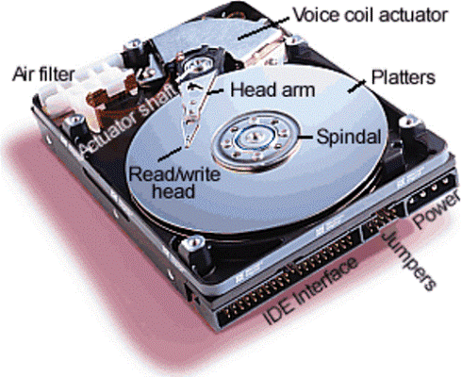
Hard Disks

Slide 20
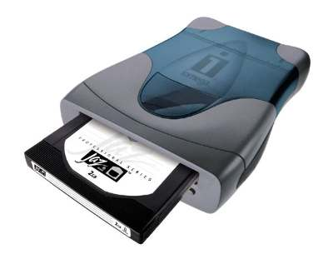
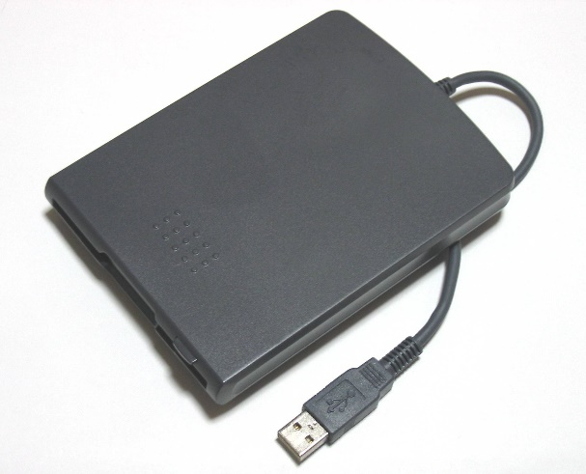
High-Capacity Magnetic Disks
Removable high capacity disks and drives combine the speed and capacity of a hard disk with the portability of a diskette.
There are basically two types of removable high-capacity magnetic disks:
High-capacity floppy disks are the same size as a 3.5-inche diskette but have a much greater capacity than a standard diskette. These are also known as Zip disk which capacity ranges from 100 MB to 750 MB.
Hot-swappable hard disks are also called removable hard disk.

Slide 21
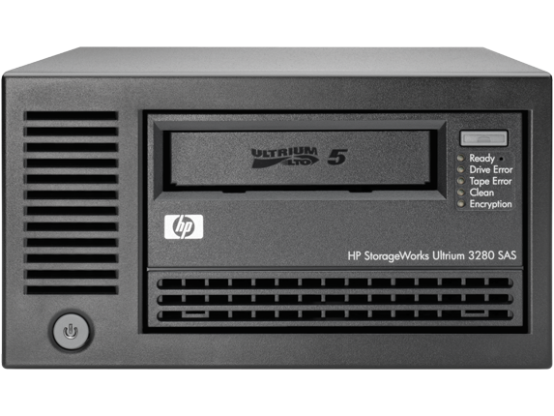
Tape
Tape drives read and write data to the surface of a tape the same way an audiocassette recorder does.
The difference is that a computer tape drive writes digital data rather than analog data.
Businesses use tape drives for data backup because they are inexpensive, reliable and have capacities as high as 200 GB.
Tape storage is best used for data that you don’t use often, such as backup copies of your hard disk’s contents.

Slide 22
Optical Storage
The most popular alternatives to magnetic storage systems are optical systems.
Optical devices store data on a reflective surface so it can be read by a beam of laser light.
A laser uses a concentrated, narrow beam of light, focused and directed with lenses, prisms and mirrors.
e.g., CD-ROM, DVD-ROM and their variants.

Slide 23
CD-ROM
CD-ROM stands for compact disk read only memory.
Data is laid out on a CD-ROM disk in a long, continuous spiral.
Data is stored in the form of lands, which are flat areas on the metal surface and pits, which are depressions or hollows.
CD-ROM drive reads digital data (either computer data or audio) from a spinning disc by focusing a laser on the disc’s surface.
Some areas of the disc reflect the laser light into a sensor, and other areas scatter the light.
A spot that reflects the laser beam into the sensor is interpreted as a 1, and the absence of a reflection is interpreted as a 0.
A standard compact disk can store 650 MB of data or about 70 minutes of audio.
A newer generation compact disk can store 700 MB of data or about 80 minutes of audio.

Slide 24
DVD-ROM
DVD-ROM stands for digital versatile/video disk read only memory.
It is a high-density medium capable of storing a full-length movie on a single disk the size of a CD.
DVD-ROM achieves such high storage capacities by using special data-compression technologies and by using extremely small tracks for storing data.
Each side of standard DVD-ROM disk can hold 4.7GB data.
These disk can store up to 9.4GB data.
Dual layer DVD-ROM disks can hold 17GB of data.

Slide 25
Recordable Optical Technologies
Here are some popular ‘writeable’ CD and DVD technologies:
CD-Recordable
CD Re-Writeable (CD-RW)
PhotoCD
DVD-Recordable
DVD-RAM→ allows to record, erase, and re-record data on a special disc.

Slide 26
Solid-state Storage
Solid-state storage is neither magnetic nor optical, instead it relies on integrated circuits to hold data.
Solid-state storages are very fast and some technologies are:
Flash memory
Found in cameras and USB drives, Combination of RAM and ROM, Long term updateable storage.
Smart cards
Credit cards with a chip, Chip stores data, Eventually may be used for cash, Hotels use for electronic keys.
Solid-state disks (SSD)
Extremely fast, Volatile storage, Require battery backups, Most have hard disks copying data.

Slide 27
Hard Disk Drive vs. SSD
SSD: Advantages
No spin-up time
Fast, random-access to data
Use less energy
Far more robust
Silent
SSD: Disadvantages
High storage cost per gigabyte
Lower drive capacities
Relatively low write speed
Difficult encryption

Slide 28
End of Chapter

