Slide 1
Lecture 8 (Chapter 11)
Online Payment Systems
Md. Mahbubul Alam, PhD
Professor

Slide 2
Intended Learning Objectives (ILOs)
The basic functions of online payment systems
The use of payment cards in electronic commerce
The history and future of electronic cash
How electronic wallets work
The use of stored-value cards in electronic commerce
Internet technologies and the banking industry
Notes:
2
2

Slide 3
Online Payment Basics
Online payment systems
    Still evolving
      Competition for dominance
    Cheaper than mailing paper checks
    Convenient for customers
    Save companies money
Costs per bill
    Billing by mail: between $1.00 and $1.50
    Internet billing and payment costs: 50 cents
  Significant environmental impact

Slide 4
Online Payment Basics (cont’d)
Four ways to purchase items (traditional and electronic)
    Cash, checks, credit cards, debit cards
      90% of all United States consumer payments
Electronic transfer: small but growing segment
    Popular example: automated payments
Credit cards
    Worldwide: 90% of online payments
    United States: 97% of online payments
    Non-card payment alternatives (PayPal) becoming increasingly popular

Slide 5
Payment Cards
Payment card
  Describes all types of plastic cards used to make purchases
  Categories: credit cards, debit cards, charge cards
Credit card (Visa, MasterCard)
  Spending limit based on user’s credit history
  Pay off entire credit card balance
    May pay minimum amount
  Card issuers charge unpaid balance interest
  Widely accepted
  Consumer protection: 30-day dispute period

Slide 6
Payment Cards (cont’d)
Debit card
    Removes sales amount from cardholder’s bank account
    Transfers sales amount to seller’s bank account
    Issued by cardholder’s bank
      Carries major credit card issuer name
Charge card (American Express)
    No spending limit
    Entire amount due at end of billing period
    No line of credit or interest charges
    Examples: department store, oil company cards
  Retailers may offer their own charge cards
  Often called store charge cards or store-branded cards

Slide 7
Payment Cards (cont’d)
Single-use cards
    Cards with disposable numbers
      Addresses concern of giving online vendors payment card numbers
      Valid for one transaction only
      Designed to prevent unscrupulous vendor fraud
    Withdrawn from the market
        Problem: required different consumer behavior
Prepaid Cards
  Cards that can be redeemed by anyone for future purchases
  People who do not want to be tempted to purchase more than they can afford
  Often called ‘gift card’

Slide 8
Payment Cards: Advantages Vs. Disadvantages
Advantage for merchants
    Fraud protection
        Can authenticate and authorize purchases using a payment card processing network
  Advantage for U.S. consumers
      Liability of fraudulent card use: $50
      Frequently waived if card stolen
  Greatest advantage
      Worldwide acceptance
        Currency conversion handled by card issuer
Disadvantage for merchants
    Per-transaction fees, monthly processing fees
      Viewed as cost of doing business
    Goods and services prices: slightly higher
Disadvantage for consumers
    Annual fee

Slide 9
Payment Acceptance and Processing
  2 general processes:
    Acceptance of payment
      Determine that the card is valid and that the transaction will not exceed any credit limit
    Clearing the transaction
    All the steps needed to move the funds from the card holder’s bank account into the merchant’s bank account

Slide 10
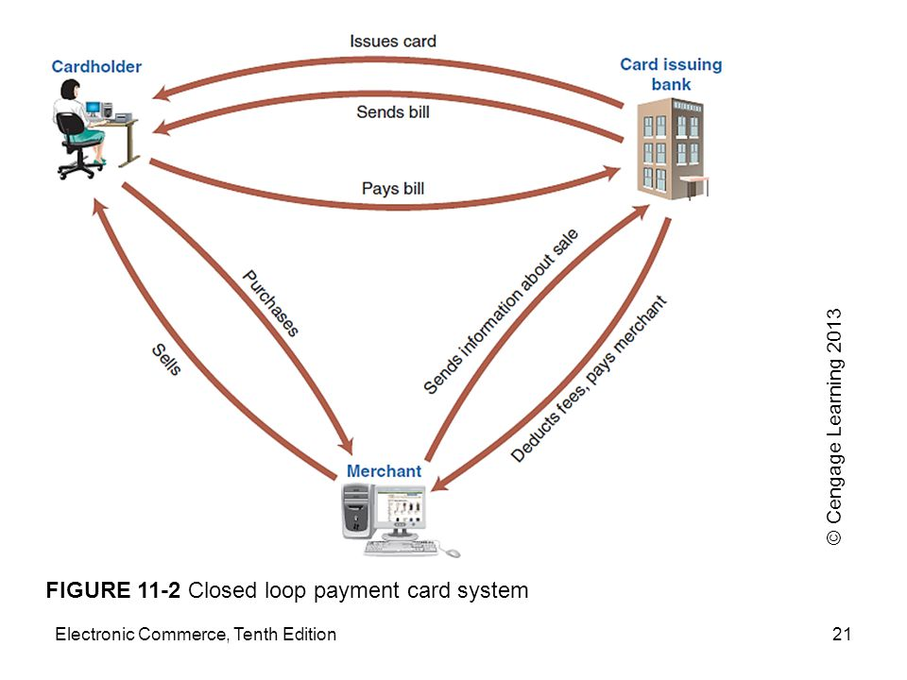
Payment Acceptance and Processing (cont’d)
  Closed loop systems
      Card issuer pays merchant directly
      Does not use intermediary, such as bank or clearing house
      e.g., American Express, Discover Card

Slide 11
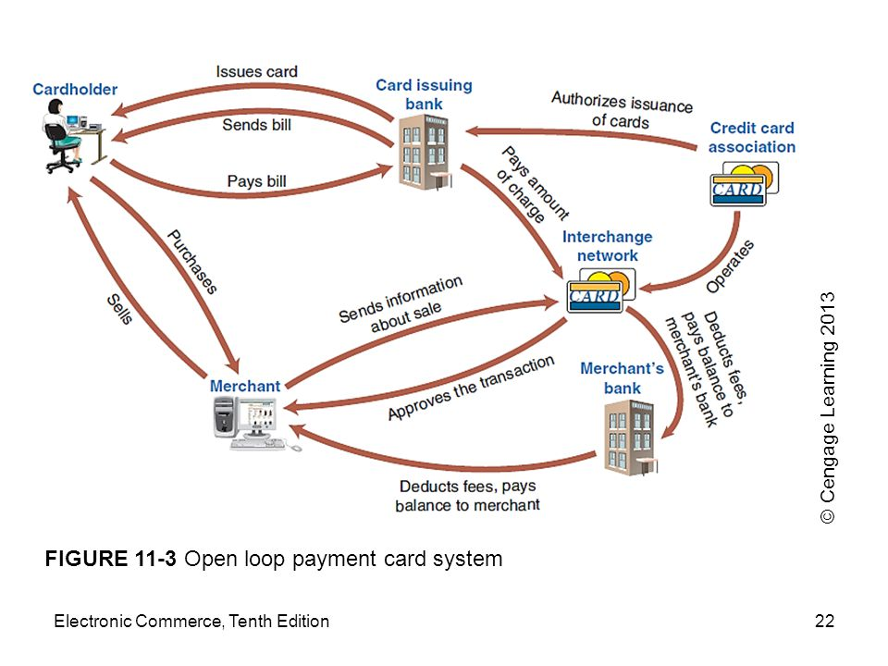
Payment Acceptance and Processing (cont’d)
  Open loop systems
    Involves three or more parties
    Add additional intermediaries
      Third party (intermediary bank) processes transaction
      Visa, MasterCard: not issued directly to consumers
      Credit card associations: operated by association member banks
      Customer issuing banks: banks issuing cards

Slide 12
Payment Acceptance and Processing (cont’d)
  Chargeback process
      Cardholder successfully contests charge
      Merchant bank must retrieve money from merchant account
      Merchant may have to cover chargeback potential
  CVN/CVV/CV2/CSC
      Three- or four-digit number printed on the credit card
      Not encoded in the card’s magnetic strip

Slide 13
Processing Payment Card Transactions
  Payment processing service providers or Payment Processors, companies offering payment card processing
      Two general types
        Front-end processor (Payment Gateways), authorizes the transaction by sending the transaction’s details to the interchange network and storing a record of the approval or denial
        Bank-end processor, receives the transaction from the front-end processor and coordinates information flows through the interchange network to settle the transaction
    Example: InternetSecure
  Automated Clearing House (ACH)
    Network of banks connecting credit card processing software vendors and card authorization companies
    Transfer funds to clear their card payment accounts with each other

Slide 14
Processing Payment Card Transactions

Slide 15
Micropayments and Small Payments
Micropayments
    Internet payments for items costing few cents to a dollar
    e.g., Millicent, DigiCash, Yaga, BitPass
      Failed to gain popularity
    Barriers
    People prefer to buy small value items in fixed price chunks, e.g., mobile phone fixed monthly payment plans
Small Payment
  Payments that are between $1 to $10
  Being offered through mobile telephone carrier
    Buyers make purchases using their mobile phones
    Charges appear on monthly mobile phone bill

Slide 16
Electronic Cash (e-Cash, Digital Cash)
  Describes any value storage and exchange system created by private (nongovernmental) entity
      Does not use paper documents or coins
      Can serve as substitute for government-issued physical currency
  Readily exchanged for physical cash on demand
Problems
    No standard among all electronic cash issuers
    Not universally accepted
Factors favoring electronic cash
    Potentially significant electronic cash market
      Internet small purchases (below $10)
    Most of world’s population does not have credit cards
characteristics of electronic cash
  Ability to spend only once
  Anonymous use, just as currency is
  Convenience

Slide 17
Holding Electronic Cash: Online and Offline Cash
Online cash storage
    Consumer has no personal possession of electronic cash
      Trusted third party (e.g., online bank) involved in all transfers, holds consumers’ cash accounts
Online system payment
    Merchants contact consumer’s bank
        Receives payment for a purchase
        Helps prevent fraud (confirm valid cash)
        Resembles process of checking with consumer’s bank to ensure valid credit card and matching name
Offline cash storage
    Virtual equivalent of money kept in wallet
    Customer holds it
      No third party involved in transaction
    Protection against fraud concern
      Hardware or software safeguards needed

Slide 18
Holding Electronic Cash: Online and Offline Cash (cont’d)
  Double-spending
      Spending electronic cash twice
      Submit same electronic currency to two different vendors
Main deterrent to double-spending
    Threat of detection and prosecution
Keys to creating tamperproof electronic cash traceable back to origins
    Cryptographic algorithms
    Two-part lock
        Provides anonymous security
        Signals an attempt to double-spend cash

Slide 19
Detecting double-spending of electronic cash

Slide 20
Advantages and Disadvantages of Electronic Cash
Advantages:
  Less costly, than other form of transactions
  No distribution method or human oversight is required
  Any additional cost is nearly zero
  Does not require any authorization, as is required with credit card transaction
Disadvantages:
  No audit trail, like physical cash it is untraceable
  Money laundering, converting money that obtained illegally into cash
  Not popular than credit card and physical currency

Slide 21
Electronic Wallets/Digital Wallet/e-Wallet
  Similar as a physical wallet
  An electronic device or software that holds credit card numbers, electronic cash, owner identification, owner contact information
  Provides information at electronic commerce site checkout counter
  Benefits:
    Consumer enters information once
      More efficient shopping
  Types
    Software-only digital wallets, e.g., Yahoo! Wallet
    Hardware-based digital wallets, NFC-Supported Mobile phone, e.g., Osaifu-Keitai in Japan

Slide 22
Electronic Wallets (cont’d): Software-based Wallet
  Server-side electronic wallet
      Stores customer’s information on remote server of merchant or wallet publisher
      No download time or installation on user’s computer
      Weakness: Security breach
      e.g., Microsoft Windows Live ID, Yahoo! Wallet
  Client-based digital wallet
      Stores information on consumer’s computer
      Disadvantages
          Must download wallet software onto every computer
          Not portable

Slide 23
Stored-Value Cards
Magnetic Strip Card
  Card hold value that can recharges by inserting them into the appropriate machine, inserting currency into the machine and withdrawing the card.
  Cannot send or receive information
  Cannot increment or decrement the value of cash stored on the card
  Processing only be done on a device into which the card is inserted
Smart Cards
  Uses tiny microchip compute processor
  Stores more information
  Performs calculations and storage operations on card
  e.g., Octopus card in Hong Kong

Slide 24
Internet Technologies and the Banking Industry
Check Processing
  Disadvantage of paper checks
      Cost of transporting tons of paper checks
      Float, delay between the time person writes check and the time check clears person’s bank
  Technologies helping banks reduce float
        2004 U.S. law: Check Clearing for the 21st Century Act (Check 21)
          Banks eliminate movement of physical checks entirely
          Retailer scans customer's check and transmitted instantly through clearing system
          Posts almost immediately to both accounts that eliminates transaction float

Slide 25
Internet Technologies and the Banking Industry (cont’d)
Mobile Banking
  Banks exploring mobile commerce potential
  2009: banks launched sites allowing customers using smart phones to:
      Obtain bank balance, view account statement, find a nearby ATM
  Future plans
      Offering downloadable applications smart phone users can install
        Use to transact all types of banking business
25

Slide 26
Criminal Activity and Payment Systems: Phishing and Identity Theft
Online payment systems
    Offer criminals and criminal enterprises an attractive arena in which to operate
      Average consumers: easy prey
      Large amounts of money provide tempting targets
  Phishing expedition
      Technique for committing fraud against online businesses customers
      Particular concern to financial institutions

Slide 27
Phishing Attacks
Basic structure
    Attacker sends e-mail message
        To accounts with potential for an account at targeted Web site
    E-mail message tells recipient: account compromised
        Recipient must log on to account to correct problem
    E-mail message includes link
        Appears to be Web site login page
        Actually leads to perpetrator’s Web site disguised to look like the targeted Web site
  Recipient enters login name, password
    Perpetrator captures
    Uses to access recipient’s account
    Perpetrator accesses personal information, makes purchases, withdraws funds

Slide 28
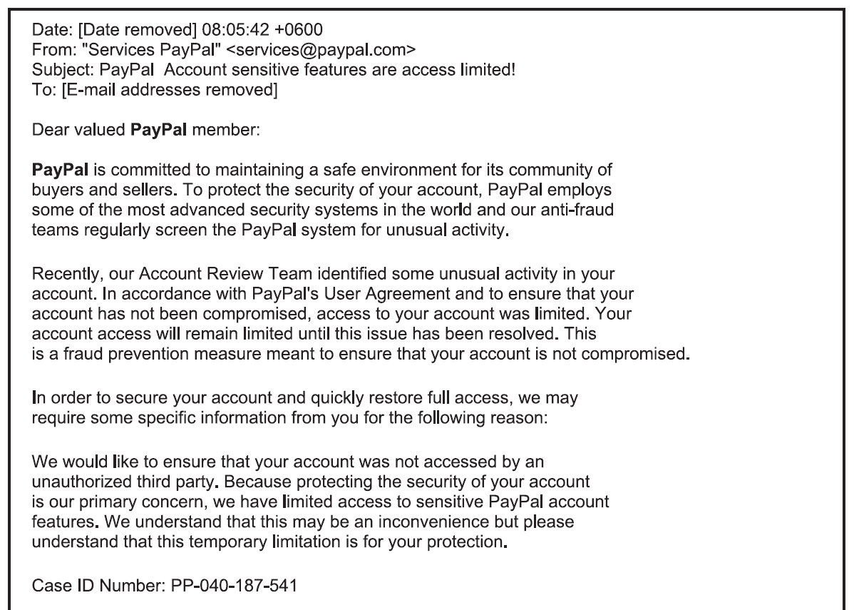
Phishing e-mail message

Slide 29
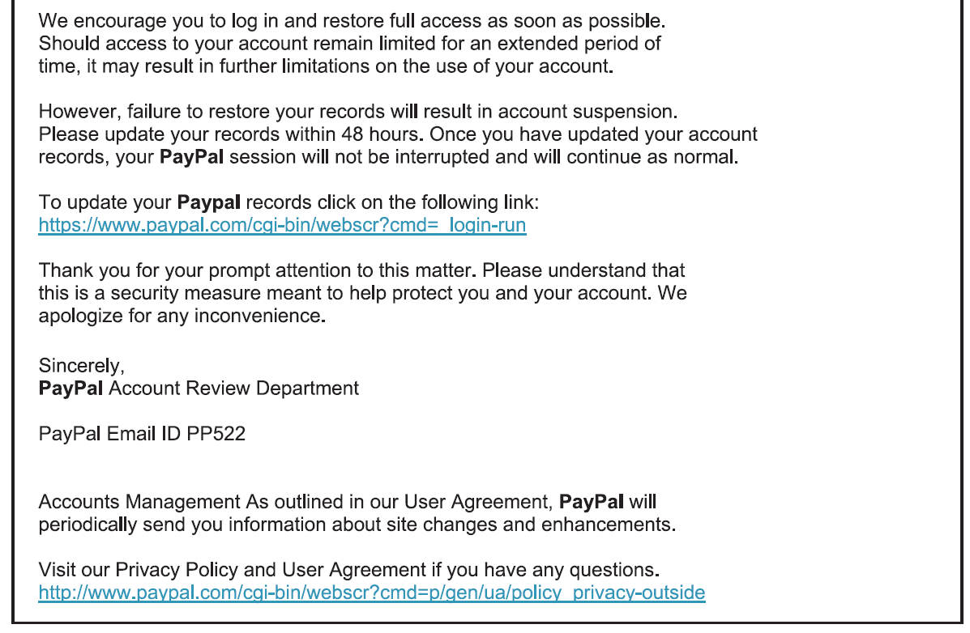
Phishing e-mail message (cont’d)

Slide 30
Phishing Attacks (cont’d)
Spear phishing
    Carefully designed phishing expedition targeting a particular person or organization
    Requires considerable research
    Increases chance of e-mail being opened
    Example: 2008 government stimulus checks
        Phishing e-mails appeared within one week of passage

Slide 31
Phishing e-mail with graphics

Slide 32
Using Phishing Attacks for Identity Theft
Organized crime (racketeering)
  Unlawful activities conducted by highly organized, disciplined association for profit
  Differentiated from less-organized groups
  Internet providing new criminal activity opportunities
    Generates spam, phishing, identity theft
Identity theft
  Criminal act: perpetrator gathers victim’s personal information
  Uses information to obtain credit
  Perpetrator runs up account charges and disappears

Slide 33
Types of personal information most useful to identity thieves

Slide 34
Using Phishing Attacks for Identity Theft (cont’d)
Large criminal organizations
  Efficient perpetrators of identity theft
      Exploit large amounts of personal information quickly and efficiently
  Sell or trade information that is not of immediate use
      Other worldwide organized crime entities
  Zombie farm
      Large number of computers implanted with zombie programs
  Pharming attack
      Hacker sells right to use zombie farm to organized crime association

Slide 35
Using Phishing Attacks for Identity Theft (cont’d)
Two elements in phishing
    Collectors: collect information
    Cashers: use information
    Require different skills
Crime organizations facilitate transactions between collectors and cashers
    Increases phishing activity efficiency, volume
Each year
    More than a million people fall victim
    Financial losses exceed $500 million

Slide 36
Phishing Attack Countermeasures
Change protocol
    Improve e-mail recipients’ ability to identify message source
      Reduce phishing attack threat
Educate Web site users
Contract with consulting firms specializing in anti-phishing work
Monitor online chat rooms used by criminals

Slide 37
Question Please
?
Acknowledgement:
“E-business” by Gary Schneider

