Slide 1
Lecture 7 (Chapter 9, G. Schneider)
Web Hosting and E-Business Software
Md Mahbubul Alam, PhD
Professor

Slide 2
Learning Objectives
Find and evaluate web-hosting services
Basic and advanced functions of electronic commerce software
How the size of a business affects its choice of electronic commerce software
Electronic commerce software for small, midsize and large businesses
2
Notes:
2

Slide 3
Hosting
  Shared hosting
      Client's Web site is on a server that hosts other Web sites simultaneously
      Operated by the service provider at its location
  Dedicated hosting
      Client Web server not shared with other clients
      Service provider owns server hardware, leases hardware to client
      Maintains Web server hardware, software and provides Internet connection
  Co-location service
      Service provider rents physical space to client
      Provides reliable power supply, Internet connection
      Clients install server hardware and software; maintain server

Slide 4
Hosting Arrangement Decision
Electronic commerce software needs determined by:
    Expected enterprise size
    Projected traffic and sales
    Budget
      Consider online store creation costs versus brick and mortar costs
      Consider external or in-house host costs

Slide 5
Basic Functions of Electronic Commerce Software (cont’d)
All electronic commerce solutions must provide
    Catalog display
    Shopping cart capabilities
    Transaction processing

Slide 6
Catalog Display
Catalog organizes goods and services being sold
  Organizes offerings into departments
  Web store advantage
      Single product may appear in multiple categories
Catalog: listing of goods and services
  Static catalog
    Simple list written in HTML that appears on a Web page or a series of Web pages
    To change or add or delete item, one must edit the HTML of one or more pages
  Dynamic catalog:
    Stores the information about items in a database,
    Allow multiple photos of each item, detailed descriptions and a search tool for customers

Slide 7

Catalog Display (cont’d)
Large, well-known electronic commerce sites
    Include many features; professional looking
    Use dynamic catalog aides and tools
Small online stores (sell fewer than 100 items)
    Require simple products or categories list
    Item organization not important
    Can provide item photos with links
    Use a static catalog
Good sites provide alternative ways to find products
    Search engine
    “Never Stand in the way of a customer who wants to buy something”.

Slide 8
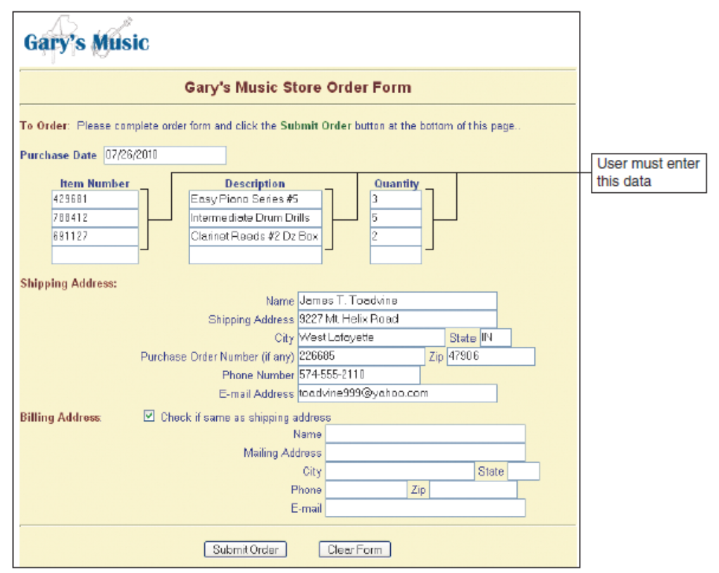
Shopping Cart
Electronic commerce early days
    Used forms-based shopping
      Shoppers selected items by filling out online forms
      Awkward if ordering more than one or two items
  Problems
      Need to write down product codes, unit prices, other information before ordering
      Customers forgot whether submit button clicked
    Confusing and error prone

Slide 9
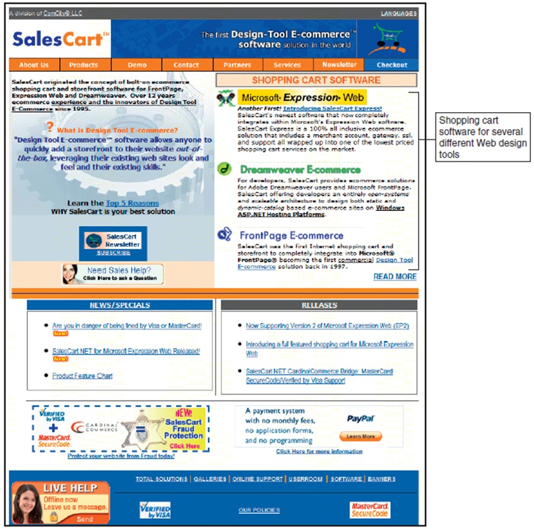
Shopping Cart (cont’d)
Electronic shopping carts
    Now the standard method for processing sales
    Keep track of items customer selected
    May view cart contents, add items, remove items
    Ordering requires a simple click
      Item details stored automatically in cart
    Button click executes the purchase transaction
      Screen asks for billing and shipping information
Shopping cart software
    BIZNET Internet Services, SalesCart, WebGenie Software

Slide 10
Shopping Cart (cont’d)
Web: stateless system
    Unable to remember anything from one transmission or session to another
How does shopping cart retrieve information later?
    Use cookies
      Allows information to be stored explicitly
      Allows unique user identification
If browser does not allow cookie storage
    Electronic commerce software automatically assigns temporary number
    e.g., ShopSite

Slide 11
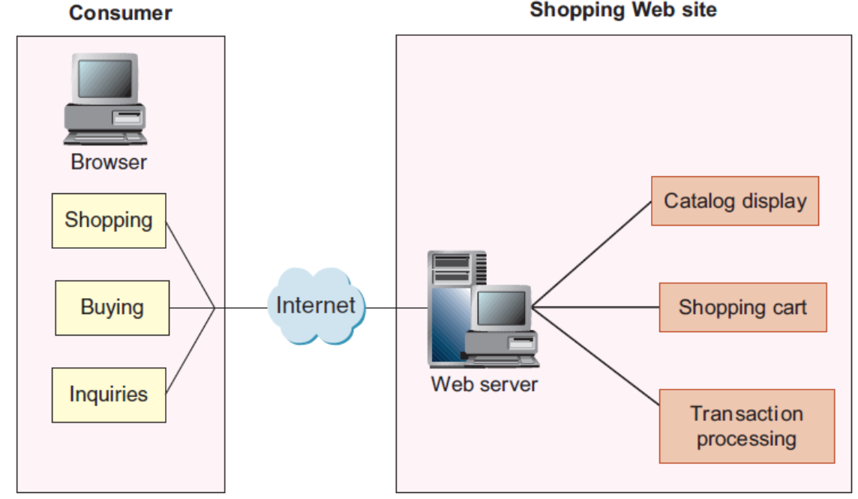
Transaction Processing
Transaction processing occurs when shopper proceeds to virtual checkout counter by clicking a checkout button
Electronic commerce software performs necessary calculations, e.g., discounts, tax, shipping costs.
Web browser software and seller’s Web server software switch into secure communication state
Fig. Basic electronic commerce Web site architecture

Slide 12
Transaction Processing (cont’d)
Most companies use accounting software package
    Records sales and inventory movements
    Requires integration with accounting software that runs on other computers
Web sites use software to update tax rates
  FedEx and UPS shipping rate software integrates with e-commerce software
Other calculations
    Coupons, special promotions, time-sensitive offers
    e.g., ‘purchase a round-trip ticket before the end of the month and receive a 50 percent discount’
Large companies
    Integration may be complex

Slide 13
Advanced Functions of Electronic Commerce Software
Databases
Middleware
Enterprise Application Integration
Integration with ERP Systems
Web Services

Slide 14
Databases
Database
    Collection of information
      Stored on a computer in a highly structured way
Business rules
    How the company does business
Database manager (database management software), is a software that
    Makes it easy for users to:
        Enter, edit, update, retrieve information in the database
    Examples: Microsoft Access, IBM DB2, Microsoft SQL Server, Oracle

Slide 15
Middleware
  Middleware is a software
    takes sales and inventory shipments information from electronic commerce software and transmits to accounting and inventory management software
  Companies can write own middleware or purchase customized middleware
Interoperability
    Making information systems work together (e.g., integrate electronic commerce software with accounting and inventory management databases or applications)
  Middleware cost range: $50,000 to several million dollars
  Major middleware vendors: BEA Systems, Broadvision, Digital River, IBM Tivoli Systems, Informatica

Slide 16
Enterprise Application Integration
Application program (application software, application)
    A program that performs specific function
    e.g., creating invoices, calculating payroll, processing payments
Application server, a computer that
    Takes request messages received by the Web server
      Runs application program that performs action based on request message’s contents
      Actions determined by business logic
Business logic
    Rules used in the business

Slide 17
Enterprise Application Integration (cont’d)
Application integration (enterprise application integration)
    Creation of links among scattered applications
    Interconnects organization’s business logic
  Accomplished by programs transferring information
      From one application to another
        Transferring information from order entry systems in several different divisions to a single accounts receivable
        Sales system that integrates all enterprise-wide sales activity
  Various program data formats differ
      Must edit and reformat data before transferring it
      Increasingly using XML data feeds to move data from one application to another

Slide 18
Enterprise Application Integration (cont’d)
Types of application servers: Page-based and component-based systems
Page-based application systems
    Return pages generated by scripts containing rules
      Present data on Web page with the business logic
      Hard to revise once the system reach a higher level of complexity
  Examples for small, midsized Web sites
      Adobe ColdFusion
      JavaServer Pages (JSP)
      Microsoft Active Server Pages (ASP)
      Hypertext Preprocessor (PHP)
Component-based application system
    Separates presentation logic from business logic
    Preferred by larger businesses
    Logic component created and maintained separately
      Updating, changing system elements much easier
  Common Web component-based systems
        Enterprise JavaBeans (EJBs)
        Microsoft Component Object Model (COM)
        Common Object Request Broker Architecture (CORBA)

Slide 19
Integration with ERP Systems
Enterprise resource planning (ERP) software packages
  Business systems integrating all facets of a business
    Accounting, logistics, manufacturing, marketing, planning, project management, treasury functions
Two major ERP vendors: Oracle and SAP
ERP software installation costs
  Between $2 million and $25 million

Slide 20
Web Services: What?
  Internet is used to connect specific software applications at one organization directly to software applications at other organizations
  Software systems supporting interoperable machine-to-machine interaction over a network
  Set of software and technologies allowing computers to use the Web to interact with each other directly without humans directing the specific interactions
Application program interface (API): programs interconnect with each other
Web Service Specifications:
  SOAP (Simple Object Access Protocol)
  REST and RESTful (Representational State Transfer )
Notes:
REST by Roy Fielding, how the Web uses networking architecture to identify and locate Web pages

Slide 21
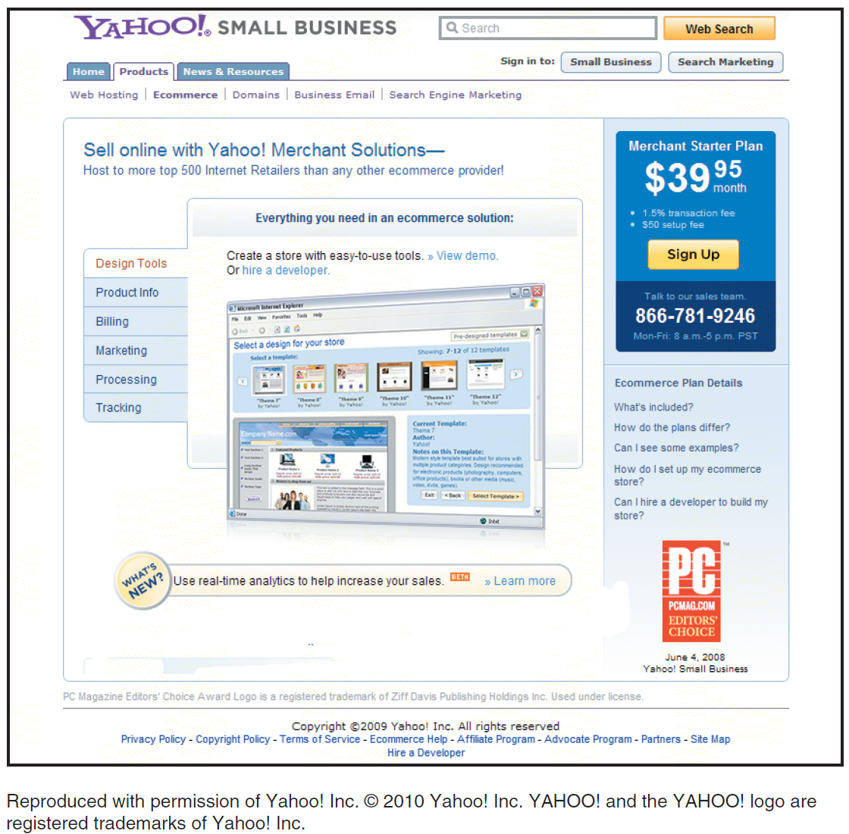
Electronic Commerce Software for Small and Midsize Companies
Basic Commerce Service Providers (CSPs)
  free or low-cost e-commerce software
    Cost: less than $20 per month
    Software built into CSP’s site
      Selling few items (no more than 50)
      Incurring relatively low transaction volumes (fewer than 20 transactions per day)
  e.g., ValueWeb, ProHosting.com, 1&1 Internet, Yahoo!

Slide 22
Electronic Commerce Software for Small and Midsize Companies (cont’d)
Mall-style Commerce Service Providers
  Online store design tools and storefront templates
  Easy-to-use interface
  Web page-generation capabilities
  Page maintenance
  Shopping cart software capabilities
  Payment processing services
  Data mining capabilities
  e.g., eBay (cost less than $20 per month), Amazon.com (transaction fee plus percentage of the selling price)

Slide 23
Electronic Commerce Software for Midsize to Large Businesses
Web Site Development Tools
  After Web site creation programmers can add purchased software elements, such as shopping cart and content management software
    Create the middleware
    More expensive than using a CSP
      $2000 to $50,000
Three midrange electronic commerce systems
    Intershop Enfinity
    WebSphere Commerce Suite by IBM
    Commerce Server by Microsoft

Slide 24
Electronic Commerce Software for Large Businesses
Enterprise-class software
  Commerce software for large-scale systems
Enterprise
  Describes system serving multiple locations of one company
  Encompasses all areas of the business or enterprise
Software provides tools for B2B and B2C commerce
Interacts with wide variety of existing systems
  Database, accounting, ERP
  Costs: $100,000 to $10 million
Requirements
  Several dedicated computers, Web server system, firewalls
Enterprise-class product examples
  IBM WebSphere Commerce Enterprise, Oracle E-Business Suite, Broadvision products
Provides tools for linking to and supporting supply, purchasing activities

Slide 25
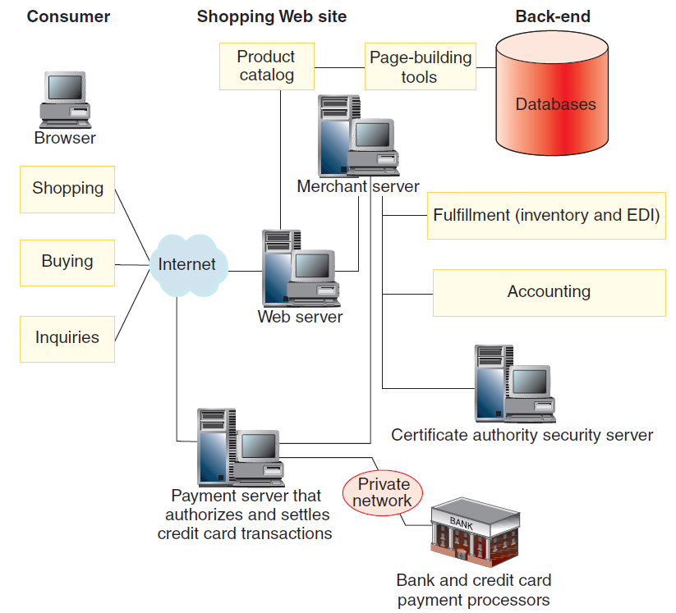
Enterprise-Class Electronic Commerce Software (cont’d)
Provides standard electronic commerce activities
  Secure transaction processing and fulfillment
  Interaction with firm’s inventory system
  Making proper stock adjustment
  Issuing purchase orders for needed supplies
  Generating other accounting entries

Slide 26
Customer Relationship Management Software (CRM)
Goal
  Understand each customer’s specific needs
  Customize product or service to meet those needs
  If customer needs met exactly they will pay more for goods or services
CRM software
  Obtains data from operations software
  Gathers data about customer activities
  Uses data to conduct analytical activities
CRM business importance
  Maintaining customer loyalty
  Maintaining positive, consistent contacts at the purchasing company
  Oracle Siebel CRM Applications
    Leading CRM software provider
  SAP CRM: another vendor
  Costs: $25,000 to millions of dollars
  Newer CRM: buyer does not have to install CRM software on its own servers
    Example: Salesforce.com

Slide 27
Supply Chain Management Software (SCM)
  Helps companies coordinate planning and operations with industry partners
Two general function types: planning and execution
SCM planning software
    Develops coordinated demand forecasts
      Uses information from each supply chain participant
SCM execution software
    Helps with warehouse and transportation management
Two major firms offering SCM software
    i2 Technologies and JDA Software
i2 Technologies product: RHYTHM
    Manages demand planning, supply planning, demand fulfillment
JDA Software
    Originally managed retail order entry and sales side of inventory control
    Example: retailer with 500 stores
      $3 million and $10 million

Slide 28
Content Management Software
  Help firms to control large amounts of text, graphics, media files
Why important?
    Increased use of smart phones, netbook computers, pad computing devices, social media
    Companies needing many different ways to access corporate information
IBM and Oracle
    Provide software as components in other enterprise software packages
  Software costs
    Between $100,000 and $500,000
    3 to 4 times higher costs in case of customized software

Slide 29
Knowledge Management Software
  Systems managing knowledge itself
    Rather than documentary representations of that knowledge
Four main tasks
    Collect and organize information
    Share information among users
    Enhance ability of users to collaborate
    Preserve knowledge gained through information use
Major software vendors: IBM, Microsoft SharePoint, BMC Software, CustomerVision
  Costs: $10,000 to $1 million or more

Slide 30
Cloud Computing
New force in the software industry
Allows companies to gain the benefits of software without having to install computing hardware and maintain it.
Users do not need to upgrade or reconfigure their servers
Vendor maintains the entire software installation at its sites.
Software users pays a subscription fee (few hundred dollars per user per year)
Popular cost-reduction strategy
Company can gain flexibility in launching new operations

Slide 31
Question Please
?
Acknowledgement:
“E-business” by Gary Schneider

