Slide 1
Lecture 1
The Second Wave of Global
E-Business (Book Chapter 1)
Md. Mahbubul Alam, PhD
Professor
Notes:
1

Slide 2
Intended Learning Outcomes (ILOs)
Electronic commerce and its second wave of growth
Analysis of business processes in order to undertake electronic commerce initiatives
Economic forces that foster the second wave of electronic commerce
Use value chains and SWOT analysis to identify electronic commerce opportunities
Challenges that arise in engaging in electronic commerce on a global scale

Slide 3
Second Wave: History
Began to show signs of new life
Companies observed the growth in sales and profits
Became a larger part of the total economy
Rapid growth stage
“Dot-com boom” followed by “dot-com bust”
Mid-1990s to 2000
2000 to early-2003
2003 to 2008
2009 to onwards
E-commerce hurt less during general economic recession
Introduction of handheld devices like mobile phones and tablet computers
High speed internet with Web 2.0 technologies
Second wave underway
Overly gloomy news reports
Predicting obituaries for electronic commerce

Slide 4
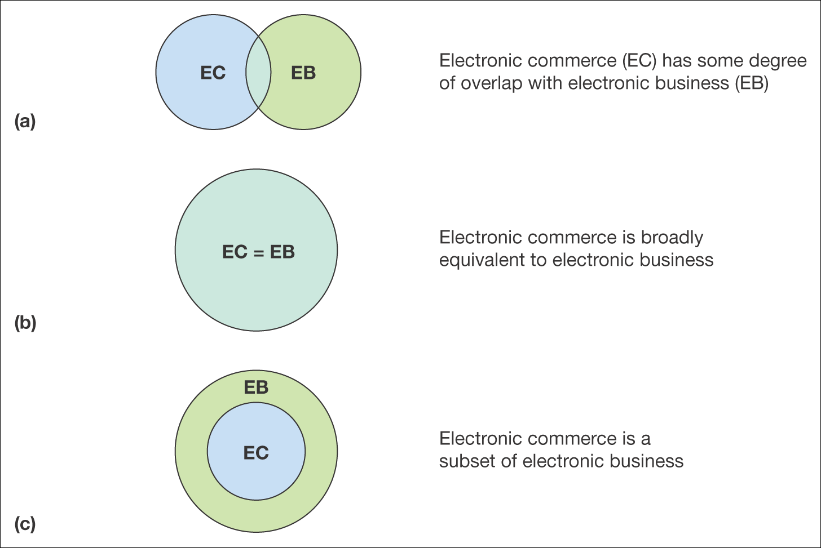

Electronic Commerce and Electronic Business
Which view is more realistic?

Slide 5
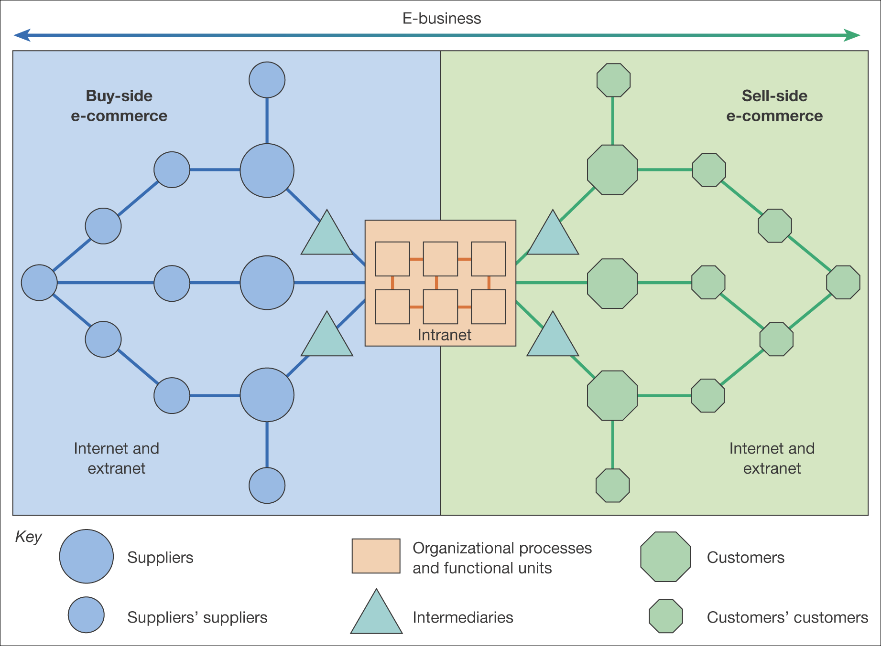
Buy-side Vs. Sell-side e-business
E-commerce transactions between a purchasing organizations & its suppliers.
Procurement of resources from suppliers.
E-commerce transactions between a supplier organization & its customers.
Selling products to an organization’s customers

Slide 6
Classification of e-Business
B2C
  e-tailer: Amazon, Dell.com, etc.
  Community Provider: iVillage, Babycenter.com
  Content Provider: WSJ.com, CNN.com, ESPN.com
  Portal: Google, Yahoo, MSN
  Transaction Broker: Expedia, Tripadvisor
  Market Creator: Amazon.com
  Service Provider: VisaNow.com, RockeLawyer
B2B
  Net Marketplace
    E-distributor: Partstore.com
    E-Procurement: Ariba, PerfectCommerce
    Exchange: OceanConnect
    Industry Consortium: Exostar
  Private Industrial Network: Walmart, Procter & Gamble
C2C: eBay,
Peer-to-Peer: Betfair.com
M-Commerce:
Business-to-Government (B2G)

Slide 7
Elements of Electronic Commerce

Slide 8
Electronic Commerce: Development & Growth
Electronic Funds Transfers (EFTs)
  Electronic transmissions of account exchange information (Wire transfers)
  Uses private communications networks
Electronic Data Interchange (EDI)
  Computer-readable data in standard format for business-to-business transmission
  Benefits: Reduces errors, avoids printing and mailing costs, eliminates need to reenter data
  EDI pioneers (General Electric, Sears, Wal-Mart)

Slide 9
Electronic Commerce: Development & Growth (cont’d)
EDI pioneers problem
  High implementation cost
    Expensive computer hardware and software
    Establishing direct network connections to trading partners or subscribing to value-added network
Value-added network (VAN)
    Independent firm offering EDI connection and transaction-forwarding services
    Ensure transmitted data security
    Charge fixed monthly fee plus per transaction charge
  Gradually moved EDI traffic to the Internet
    Reduced EDI costs

Slide 10
First vs. Second Wave of E-commerce
Characteristics | First wave | Second wave
Regional scope | US phenomenon | International
Start-up capital | Easy to obtain | Companies using internal funds
Internet technologies used | Slow and inexpensive | Broadband connections
Internet technologies integration | Bar codes, scanners | RFID, smart cards, biometric technologies
Revenue source | Simple online advertising | Multiple sophisticated Internet advertising approaches
Digital product sales | Fraught with difficulties, e.g. music industry | Fulfilling available technology promise, e.g. mobile commerce, smart phone, Web 2.0
Business online strategy | First mover advantage | Not rely on first mover advantage
Notes:
1. Language: English vs multiple languages

Slide 11
Business & Revenue Models, and Business Processes
  A Set of processes combined to achieve company goal, which is typically to yield a profit.
    Electronic commerce first wave
      Investors sought Internet-driven business models
      Expectations of rapid sales growth, market dominance
      Saw copying of successful “dot-com” business models
    Electronic commerce second wave
      Instead of copying model, examine business elements
      Streamline, enhance, replace with Internet technology driven processes

Slide 12
Business & Revenue Models, and Business Processes (cont’d)
Revenue model
  A Specific collection of business processes
    Identify customers
    Market to those customers
    Generate sales
  Helpful for classifying revenue-generating activities
    Communication and analysis purposes

Slide 13
Revenue model: Focuses
Focus on Specific Business Processes
  Companies think in terms of business processes
    Purchasing raw materials or goods for resale
    Converting materials and labor into finished goods
    Managing transportation and logistics
    Hiring and training employees
    Managing business finances
  Identify processes benefiting from e-commerce technology
    Improve existing business processes, identify new business opportunities, adapt to change

Slide 14
Revenue model: Focuses (cont’d)
Role of Merchandising
  Combination of store design, layout, product display knowledge
  Salespeople skills are to identify customer needs and find products or services meeting needs
Product/Process Suitability to Electronic Commerce
  Some products are good candidate for electronic commerce
  A commodity item, a product or service that is hard to distinguish from the same products or services, standardized and well known features except price.
  Shipping profile, collection of attributes affecting how easily that product can packaged and delivered, i.e., value-to-weight ratio, e.g. DVD

Slide 15
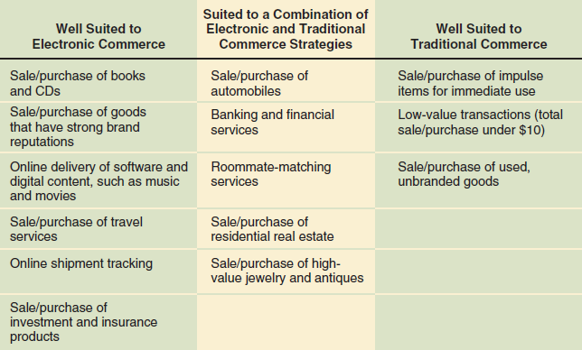
Product/Process Suitability to Electronic Commerce

Slide 16
Electronic Commerce: Advantages
E-commerce increases sales and decreases costs
  Increases purchasing opportunities
  Identifies new suppliers and business partners
  Efficiently obtains competitive bid information
  Easier to negotiate price and delivery terms
  Increases speed, information exchange accuracy
  Wider range of choices available 24 hours a day and immediate access to information
  Provides fraud, theft loss protection,
  easier to audit and monitor
  Faster transmission

Slide 17
Electronic Commerce: Disadvantages
Poor choices for electronic commerce, e.g. perishable foods, high-cost items,
Need for critical mass, e.g. online grocery like Peapod, Tesco, FreshDirect,
Predictability of costs and revenues, hard to determine with accuracy
Technology integration issues, difficulty of integrating existing databases & transaction-processing software
Cultural and legal concerns, online anxiety/fear, resistant to change habit, unfavorable govt. regulations for electronic commerce

Slide 18
Electronic Commerce: Economic Forces
Transaction costs, total of all costs that a buyer and seller incur as they gather information and negotiate a purchase-and-sale transaction, e.g. information search cost, acquisition cost, sales commission
Markets and Hierarchies, Manufacturing innovations increased monitoring activities’ efficiency and effectiveness
    SBU (Strategic Business unit), one particular combination of product, distribution channel, and customer type, e.g. General Elecctric
  Network economic structures, strategic alliances or partnership
  Network effects, value of the network to each participant increases, e.g. mobile phone coverage,
    Law of diminishing returns

Slide 19
Identifying Electronic Commerce Opportunities
Strategic business unit value chains
Industry value chains
SWOT analysis

Slide 20
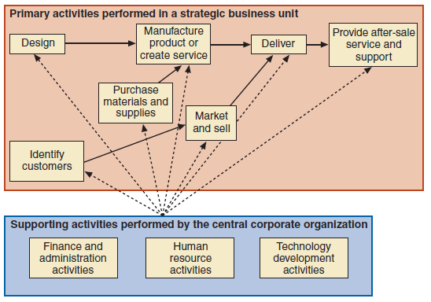
Value chain for a strategic business unit

Slide 21
Examine where strategic business unit fits within industry
Industry value chain refers to value systems
Industry value chain identifies opportunities up and down the product’s life cycle for increasing the efficiency or quality of the product.
Allows identification of new opportunities
Useful way to think about general business strategy
Value chain for a strategic business unit

Slide 22
SWOT analysis questions

Slide 23
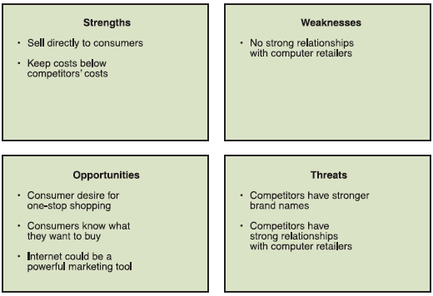
Results of Dell’s SWOT analysis

Slide 24
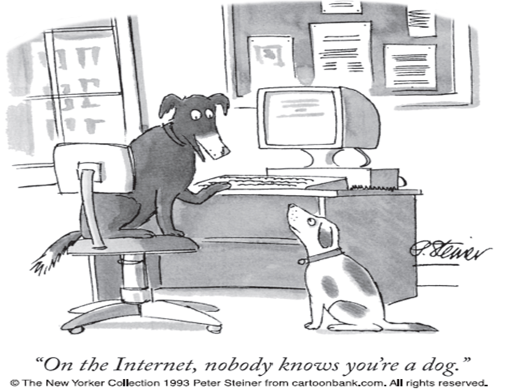
International Nature of Electronic Commerce
  Trust
    Mostly rely on brand names
    Anonymity exists in web presence
    Must overcome distrust in Web “strangers”
  Culture
    Combination of language and customs
    Personal property concept, privacy
    Online discussion inhospitable to cultural environments

Slide 25
International Nature of Electronic Commerce (cont’d)
  Language
    ‘think globally, act locally’
    May require multiple translation
  Government
    Internet censorship
  Infrastructure
    Freight forwarder, arranges shipping & insurance for transaction
    Customs broker, arranges the payment of tariffs and compliance with customs laws
    Bonded warehouse, secure location where incoming international shipments can be held until customs requirements are satisfied or until payment arrangements are completed.

Slide 26
Parties involved in a typical international trade transaction

Slide 27

Acknowledgement:
Gary Schneider. E-Business. International Edition, Cengage Learning.

