Slide 1
Lecture 2 Components of GIS
Md. Mahbubul Alam, PhD
Dept. of AEIS, SAU

Slide 2
Intended Learning Outcomes (ILOs)
GIS: Introduction
Components of GIS

Slide 3
Geographic Information System (GIS)
An application deals with spatial information on a computer.
“A system designed to capture, store, manipulate, analyze, manage, and present all types of geographical data”.
Integrates hardware, software, and data for capturing, managing, analyzing, and displaying all forms of geographically referenced information.

Slide 4
Geographic Information System (GIS) (cont’d)
Allows to view, understand, question, interpret, and visualize data that reveal relationships, patterns, and trends in the forms of maps, reports and charts.
Helps to ask questions and solve problems by looking at your data in a way that is quickly understood and easily shared.

Slide 5
Components of GIS
Hardware
Software
People
Method
Data

Slide 6
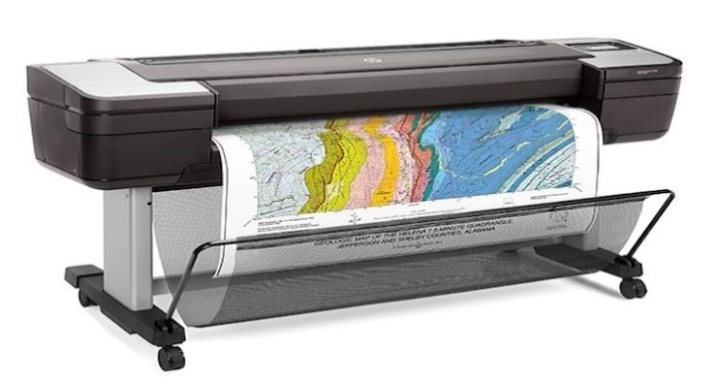
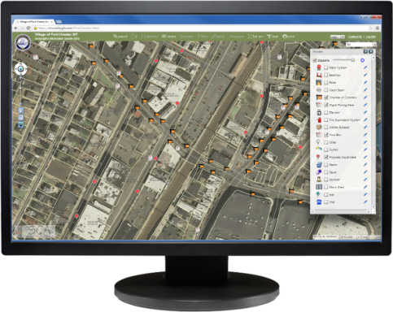
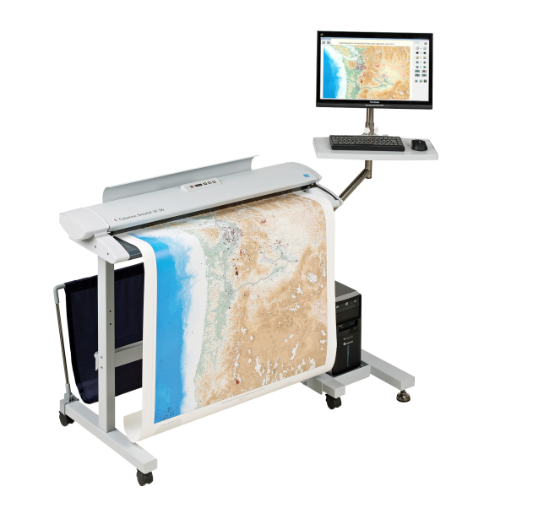
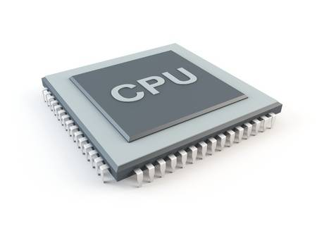
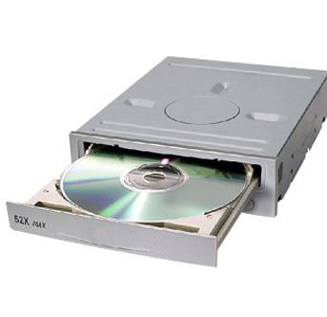
Plotter/Printer:
Used to present the result of data processing
Output/Monitor
Digitizer/scanner:
Converting data (map, documents) to digital form and send to computer
Input devices
Central Processing Unit (CPU):
General hardware components of GIS
Hardware
Storage device/tape device:
Store data or program on magnetic tape

Slide 7
Integrated Land and Water Information System
Programs and user interface for driving the hardware.
Important to generate, store, analyze, manipulate & display geographic information or data.
User friendly, functional, compatible, updateable, documentable, & cost-effective.
Software

Slide 8
GIS Software: Functions
Data capture
No data, no GIS
Import digital data from a disk, network or database
Digitizing it trough the use of peripheral devices
Data management
Adding, duplicating, deleting spatial & attribute data
Creation & management of metadata
Use tool to detect errors & to perform transformations to another aspect of data management

Slide 9
GIS Software: Functions (cont’d)
Data analysis
Ask questions related to space
Provides tools for query and retrieve data
Provide functions for data integration and modeling
Data visualization
Present data in tabular form, over graph/chart and print maps
Also visualize data in digital movie form (DEM: Digital Elevation Model)
Output can be stored in disk or web server, provides dynamic views of data

Slide 10
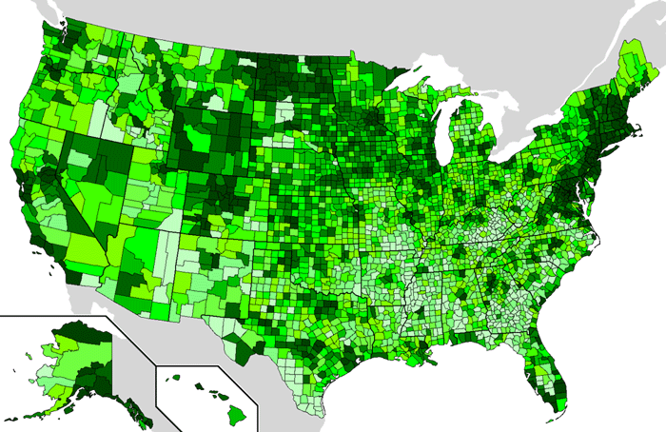
Data
Most important component of GIS
Geographic data & related tabular data can be collected in-house, compiled to customer specifications and requirements, or purchased from a commercial data provider.
GIS integrate spatial data with other existing data resources.
Integration of spatial & tabular data stored in a DBMS
Notes:
1. Difference between GIS and other IS: Handle and process geographically referenced data.

Slide 11
Data (cont’d)
Describe both the location and characteristics of spatial feature on earth surface
Geographically referenced data
Spatial data
Attribute data
Describes the absolute & relative location of geographic feature
Relate to geometry of a spatial feature
Characteristics of spatial features
Often referred to as tabular data
Gives information about the spatial features

Slide 12
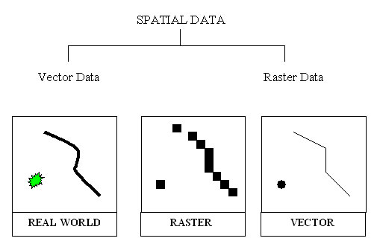
Data (cont’d)

Slide 13
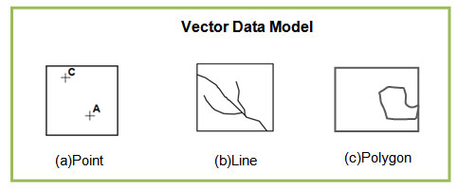
Data (cont’d)
Vector:
Points: discrete location of geographic feature, e.g., location, telephone pole, etc.
Line: Made of two or more coordinates, have begin and end point (two XY coordinate points)
Area (polygons): Closed figures that represent shape and location of homogeneous feature such as states, soil types
Raster
Common type of image file
Comprised of grid of pixels where each pixel represents an individual color within the image.
Raster: .png; .jpeg; .gif; .tiff; .ps
Vector: .ai; .eps; .pdf; .svg
Database: A technique to store, organize and manipulate data.
Notes:
vector: .ai (Adobe Illustrator Artwork), .eps (Encapsulated PostScript Vector Graphics), .pdf (Portable Document Format), .svg (Scalable Vector Graphics)
Raster: .png (Portable Network Graphics), .jpeg, .gif (graphic interchange format), .tiff, .ps(Adobe Photoshop)

Slide 14
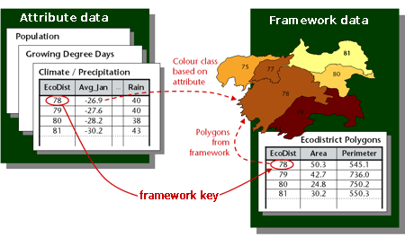
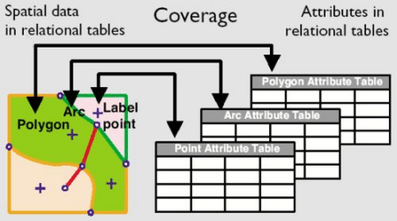
Attribute Data
Georelational data model links spatial data and attribute data by id.
Attribute data stored in feature attribute table which contains the id.
Row is called a record, column is called a field or an items.

Slide 15
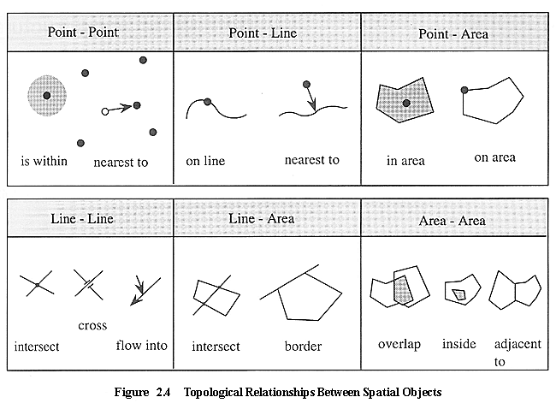
Method
Related to the management aspect of GIS data
Techniques uses for input, analyze & query of data determine the quality and validity of the final product.
Topological relationship: deals with the spatial and structural properties of geometric objects.
Ref: http://www.gitta.info/SpatialQueries/en/html/TopoBasedOps_learningObject1.html

Slide 16
People
GIS technology is of limited value without the people who manage the system and develop plans for applying it to real world problems.
People
Technical Specialists
End users
Design and maintain the system
Use to perform their everyday work
Identification of GIS specialist and end users are often critical to the proper implementation of GIS.

