Slide 1
COMB 353: Fisheries Information Systems Lecture 1: Information Systems in Today’s Organization by Md. Mahbubul Alam, PhD Professor Dept. of Agril. Extension & Information System

Slide 2
Learning Objectives
Roles of IS in organization
Interdependence between IS and organization
Why should we invest in IS?
Concept of MIS

Slide 3
Role of IS in Business Today
How information systems are transforming business
Increase in wireless technology use, Web sites
Increased business use of Web 2.0 technologies
Cloud computing, mobile digital platform allow more distributed work, decision-making, & collaboration
Globalization opportunities
Internet has drastically reduced costs of operating on global scale
Presents both challenges and opportunities

Slide 4
What’s New in MIS? (1)
Change in Technology | Business Impact
Cloud computing | A flexible collection of computers on the Internet. Perform tasks traditionally performed on corporate computers. e.g., Dropbox, SkyDrive
Growth in software as a service (SaaS) | Major business applications are now delivered online as an Internet service.
Mobile digital platform | iTunes (Apple) store Google Play (Android) Ipad Smart Phone

Slide 5
What’s New in MIS? (2)
Change in Management | Business Impact
Online collaboration & SNS software (to improve coordination, collaboration & knowledge sharing) | Google Apps, Google Sites, Microsoft’s Windows SharePoint Services, IBM’s Lotus Connections used by over 100 million business professionals for managing blogs, project management, online meeting, personal profiles, online communities.
Business Intelligence (BI) | Data analytics, provide real time performance information Efficient decision making
Virtual Meeting Proliferate | Telepresence video conferencing, Skype Web conferencing Reduced travel time, cost Improved collaboration & decision making
Notes:
1. Recently BD Govt. asked all the officials in different Ministries to open FB account and use FB for official purpose. Do you think it is wise decision? What are the opportunities? What are the threats?

Slide 6
What’s New in MIS? (3)
Change in Organizations | Business Impact
Web 2.0 | Enable employees to interact as online communities Blogs, wikis, e-mail, and instant messaging services. Facebook and MySpace create new opportunities for business to collaborate with customers and vendors.
Telework | Virtual Office/remote work program The Internet and mobile handheld devices, such as netbooks, iPads, iPhones, and BlackBerrys
Co-creation of business value | Shifting Business Value internal sources to networks of suppliers and collaboration with customers. Supply chains and product development are more global and collaborative. Customers help firms define new products and services.
Notes:
55 percent of U.S.businesses have some form of remote work program.

Slide 7
In the emerging, the fully digital firm
Significant business relationships are digitally enabled and mediated
Core business processes are accomplished through digital networks
Key corporate assets are managed digitally
Digital firms offer greater flexibility in organization and management
Firms are now more keen to be benefitted from globalization
Time shifting, space shifting
e.g., Accenture, Microsoft, Dell
Digital firms are ideally suited for global operations by allowing business to be conducted at any time and any place
Notes:
Time shifting and space shifting are connected to globalization. Why a digital firm is more likely to benefit from globalization than a traditional firm; the right idea is that by allowing business to be conducted at any time (time shifting) and any place (space shifting), digital firms are ideally suited for global operations which take place in remote locations and very different time zones.

Slide 8
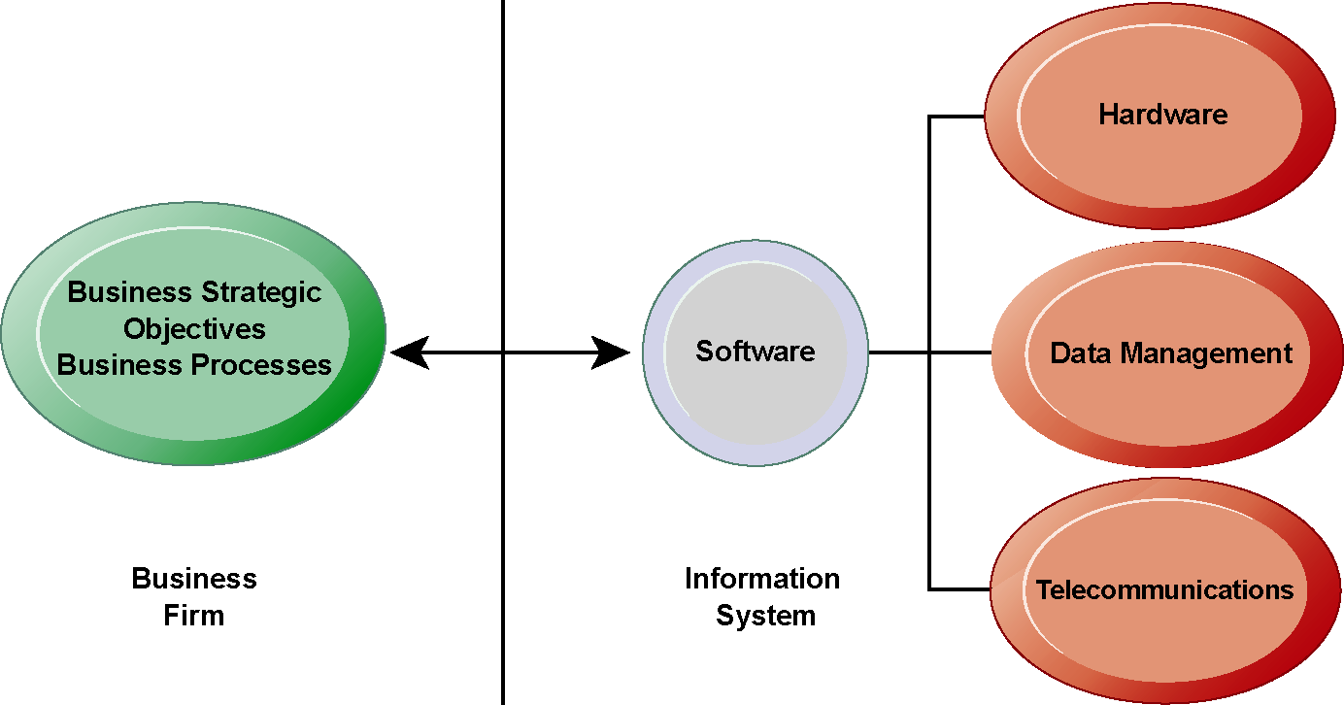
Interdependence between Organizations & IT
In contemporary systems there is a growing interdependence between a firm’s information systems and its business capabilities.
Changes in strategy, rules, and business processes increasingly require changes in hardware, software, databases, and telecommunications. Often, what the organization would like to do depends on what its systems will permit it to do.
Notes:
Key notes: business deploy IT (for survival, without IT business will fall). Once deployed IT changes business. Thereafter, introduce change in any process (IT or business) depends on what its IT or business will permit it to do.
In order to achieve its business objectives, a firm will need a significant investment in IT. Going the other direction (from right to left), having a significant IT platform can lead to changes in business objectives and strategies.
Emphasize the two-way nature of this relationship. Businesses rely on information systems to help them achieve their goals; a business without adequate information systems will inevitably fall short. But information systems are also products of the businesses that use them. Businesses shape their information systems and information systems shape businesses.

Slide 9
Why Firms Invest in IS?
To achieve six strategic business objectives
Operational excellence
New products, services, & business models
Customer & supplier intimacy
Improved decision making
Competitive advantage
Survival

Slide 10
Operational excellence
Improvement of efficiency to attain higher profitability
Information systems, technology an important tool in achieving greater efficiency and productivity
Wal-Mart’s RetailLink system links suppliers to stores for superior replenishment system
Q. Does operational excellence make a difference for customer purchasing?
Notes:
Operational excellence at end-user: ease of use
Wal-Mart is the most efficient retailer in the industry and exemplifies operational excellence. You could ask students to name other businesses that they believe to exhibit a high level of operational excellence. Do customers perceive operational excellence? Does it make a difference for customer purchasing? What Web sites strike students as really excellent in terms of customer service? If you have a podium computer, you might want to visit the Wal-Mart site and the Amazon site to compare them in terms of ease of use.

Slide 11
New products, services, & business models
Business model
describes how company produces, delivers, and sells product or service
Information systems and technology a major enabling tool for new products, services, business models
Apple’s iPod, iTunes, and iPhone, Netflix’s Internet-based DVD rentals
Notes:
You could ask students to name other new products or business models that they’ve encountered and how they might relate to new information systems or new technology. One way to encourage participation is ask students to help you list on the blackboard some really interesting recent digital product innovations. Discussing “green technologies” like wind, solar, and hybrid vehicles is always fun. In this context, what role will IT be playing in the development of these technologies?
Example: wearable device, google watch or glass.

Slide 12
Customer & supplier intimacy
Serving customers well leads to customers returning, which raises revenues and profits
High-end hotels that use computers to track customer preferences and use to monitor and customize environment
Intimacy with suppliers allows them to provide vital inputs, which lowers costs
J.C.Penney’s information system which links sales records to contract manufacturer
Notes:
You could ask students what types of companies might rely more on customer and supplier intimacy more than others and which companies they feel have served them exceptionally well. Ask the students to identify online sites that achieve a high degree of customer intimacy. Sites to visit would include NetFlix, Amazon, and other sites which have recommender systems to suggest purchase ideas to consumers.
Example: Customer Membership Card

Slide 13
Improved decision making
Without accurate information:
Managers must use forecasts, best guesses, luck
Example
Overproduction
underproduction of goods and services
Misallocation of resources
Poor response times, Poor outcomes (raise costs, lose customers)
Verizon’s Web-based digital dashboard to provide managers with real-time data on customer complaints, network performance, line outages, etc.
Notes:
Exceptional service from a company made possible by improved decision-making and whether or not information systems contributed to that level of service. For example, perhaps they had a power outage and it took a very short (or very long) time for the company to correct the error.

Slide 14
Competitive advantage
Delivering better performance
Charging less for superior products
Responding to customers and suppliers in real time
Apple, Walmart, etc.
One way to achieve competitive advantage is to achieve the previous four objectives
Notes:
Emphasize that achieving any of the previous four business objectives represents the achievement of a competitive advantage as well.

Slide 15
Survival
Industry-level changes
introduction of ATMs
Governmental regulations requiring record-keeping
Toxic Substances Control Act, Sarbanes-Oxley Act
Notes:
Ask students if they can name any examples of companies that failed to survive due to unwillingness or inability to update their information systems. The Sarbanes-Oxley Act requires that public firms keep all data, including e-mail, on record for 5 years. You could ask students if they appreciate why information systems would be useful towards meeting the standards imposed by this legislation.

Slide 16
Concept of MIS
Information system
Set of interrelated components
Collect, process, store & distribute information
Support decision making, coordination, & control

Slide 17
Concept of MIS (Cont’d)
Business challenges
Select technology
Monitoring cost
Management
Complex environment
Labor condition
Global economic condition
Revise job & work processes
Organization
Information Systems
Business solutions
Expedite communication
Track work status in real time
Increase efficiency
Lower costs
Technology
Deploy wireless network
Deploy Skype
Deploy internet and PCs

Slide 18
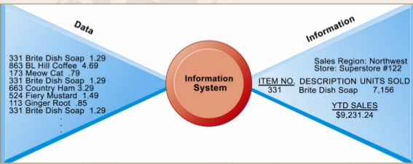
Information Vs. Data
Information
is a processed data that are represented facts, and thereby assist decision-making process.
meaningful facts
e.g., total unit sales or total sales revenue from a product
Data
raw fact that represents events occurring in an organization
e.g., customer record, data at the sales counter

Slide 19
What is a system?
System
A system is a set of elements which are joined together to achieve a common objective.
Elements are interdependent and interrelated.
Three elements
Input: captures or collects data from within the organization or from its external environment.
Process: converts raw input into a meaningful form.
Output: transfers the processed information to the users.

Slide 20
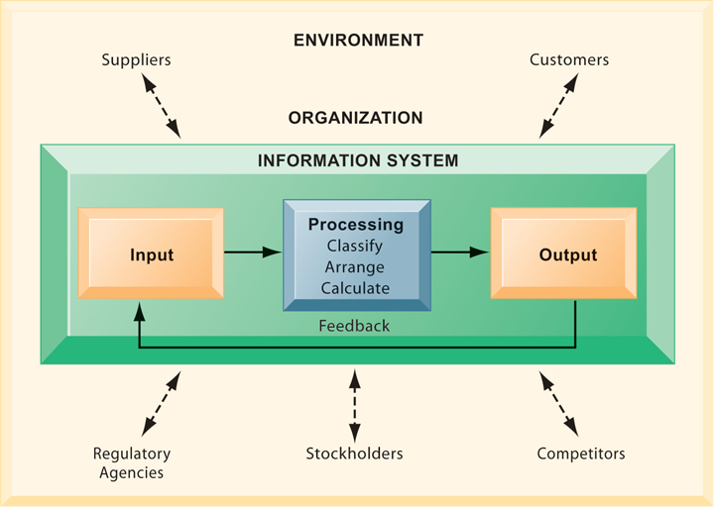
Functions of an IS
An information system contains information about an organization and its surrounding environment. Three basic activities—input, processing, and output—produce the information organizations need.
Feedback is output returned to appropriate people or activities in the organization to evaluate and refine the input.
Environmental actors, such as customers, suppliers, competitors, stockholders, and regulatory agencies, interact with the organization and its information systems.
Notes:
The point of this diagram is first of all to highlight the three basic activities of information systems.
But the diagram also puts information systems into the context of organizations (firms), and then puts the firm into its respective environment composed of shareholders, higher level authorities (government), competitors, suppliers and customers. The systems play a key role in the operations and survival of the firm.
You could also explain this diagram by relating it back to the opening case, as the book does. The two types of input into the Synergy system are manually entered data as well as video. The system processes that data and creates the output, video and statistics about specific types of players and plays.

Slide 21
Technology dimension of IS
Computer hardware and software
Hardware: processor, memory, hard disk, etc.
Software: set of computer programs that controls computer hardware
Data management technology
Networking and telecommunications technology (Networks)
Networks, the Internet, intranets and extranets, World Wide Web, LAN
IT infrastructure: provides platform that system is built on
Notes:
Information technology is at the heart of information systems. While organization and management are important too, it’s the technology that enables the systems and the organizations and managers who use the technology.
The distinction between the Internet and intranets & extranets has to do with their scope. Intranets are private networks used by corporations and extranets are similar except that they are directed at external users (like customers and suppliers). In contrast, the Internet connects millions of different networks across the globe. Students may not immediately understand this distinction.

Slide 22
Organizational dimensions
Top
Management
Middle Management
Operational Management
Business organizations are hierarchies consisting of three principle levels.
Three levels
Top management
Middle management
Scientists & knowledge workers
Operational management
Production & service workers
Data workers

Slide 23
Management dimension of IS
Managers set organizational strategy for responding to business challenges
In addition, managers must act creatively
Creation of new products and services
Occasionally re-creating the organization

Slide 24
Business perspective on IS
Information system is instrument for creating value
Investments in information technology will result in superior returns:
Productivity increases
Revenue increases
Superior long-term strategic positioning
However, investing in information technology does not guarantee good returns
Considerable variation in the returns firms receive from systems investments
Good IT but Bad Management!
Factors:
Adopting the right business model
Investing in complementary assets (organizational and management capital)
Notes:
Consider how this view of information systems might contrast with the sociotechnical view or other views. You could also ask them to consider the circumstances under which information systems might not result in increased productivity and revenue.
Many firms make significant investments in IT for very little benefit to the bottom line. Discuss why companies experience a wide variety of outcomes in their efforts to invest in IT. Consider the factors we use in this book: organizational and management factors.

Slide 25
IS Opportunities & Challenges
Opportunities
Increase worker productivity
Enhance decision making
Improve team collaboration
Create business partnerships and alliances
Enhance global competitiveness
Support corporate strategy
Improve quality of goods and services
Rapidly changing technology
Challenges:
Workforce downsizing
Information overload
Employee mistrust
Difficult to build
Security breaches
Rapidly changing technology

Slide 26
Question Please
?

