Slide 1
MAFI 420: Management Information Systems Exercise 3: The Internet and Wireless Technology by Md. Mahbubul Alam, PhD

Slide 2
Learning Objectives
How does the Internet and Internet technology work and how do they support communication and e-business?
What are the principal technologies and standards for wireless networking, communication, and Internet access?
Why are radio frequency identification (RFID) and wireless sensor networks valuable for business?

Slide 3
What is the Internet?
Internet
A interconnected network of thousands of networks and millions of computers liking businesses, educational institutions, government agencies, and individuals.
Provides services to approximately 2.56 billion people around the world.
World Wide Web (Web)
One of the Internet’s most popular services, providing access to over 6 billion Web pages.
Webpages, documents created in a programming language called HTML that can contain text, graphics, audio, video & other objects & “hyperlinks”.
Hyperlinks, permit users to jump easily from one page to another.
Webpages are navigated using browser software.

Slide 4
Evolution of the Internet
Basic ideas and technology were developed. | Ideas are brought to life. | Once the ideas and technologies had been proven, private companies brought the Internet to millions of people worldwide.

Slide 5
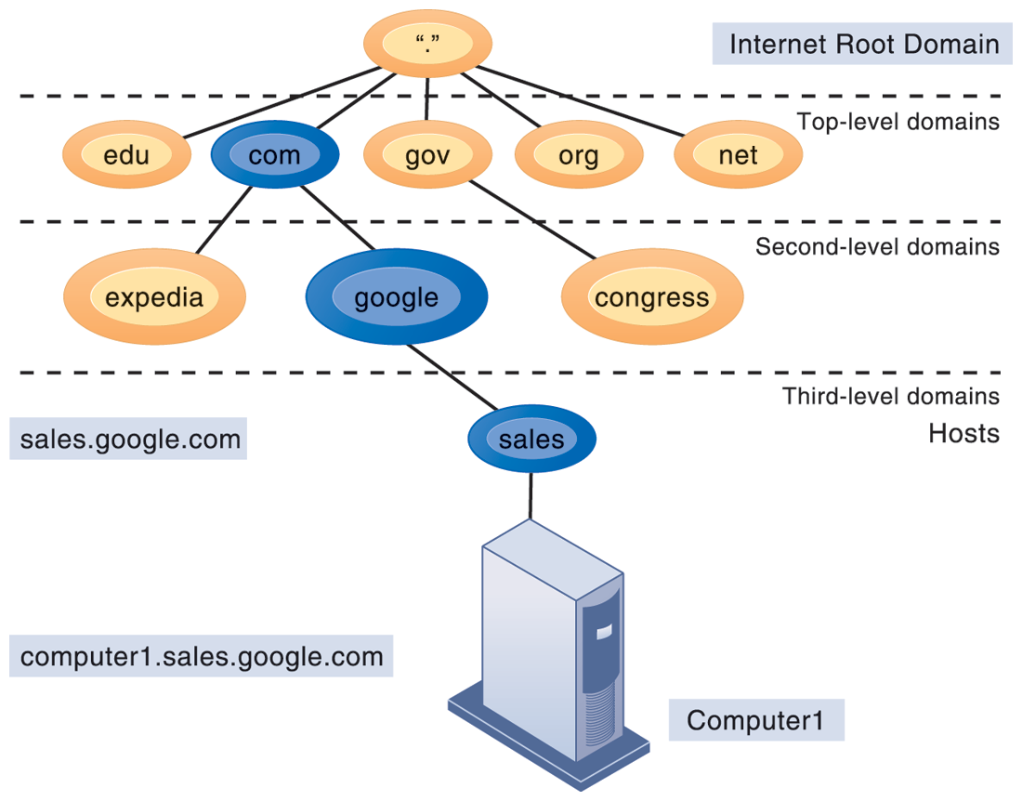
Internet Address Architecture: Domain Names, DNS, URLs
Domain name: IP address expressed in a natural language convention called a domain name.
Domain name system (DNS): allows numeric IP addresses to be expressed in natural language
Example: cnet.com = 216.239.113.101
Uniform resource locator (URL): addresses used by Web browsers to identify location of content on the Web.
DNS is a hierarchical namespace. Root server at the top.
Top-level domains → organization type or geographic location.
Second-level Servers →organizations & individuals. (e.g., nyu.edu)
Third-level servers → a particular computer(s) of an organization. (e.g., www.finance.nyu.edu)

Slide 6
The Internet Architecture
The Internet backbone connects to regional networks, which in turn provide access to Internet service providers, large firms, and government institutions.
Network access points (NAPs) and metropolitan area exchanges (MAEs) are hubs where the backbone intersects regional and local networks and where backbone owners connect with one another.

Slide 7
The Internet Architecture (cont’d)
Backbone
High-bandwidth fiber-optic cable that transport data across the Internet which is owned by ‘Network Service Provider (NSP)’.
Bandwidth
Measured how much data can be transferred over a communication medium within a fixed period of time.
Usually expressed in bps, Kbps, Mbps, Gbps
Internet Exchange Points (IXPs)/ Metropolitan Access Exchanges (MAEs)
Hub where the backbone intersects with local & regional networks and where backbone owners connect with one another.
Campus Area Network (CAN)
A local area network operating within a single organization that leases access to the Web directly from regional & national carriers.
Up to 1000 meters (a mile), a college campus or corporate facility

Slide 8
The Internet Architecture (cont’d)
Internet Service Provider (ISP)
Firm that provides the lowest level of service in the multi-tiered Internet architecture by leasing Internet access to home owners, small businesses, & some large institutions.
Narrowband
Traditional telephone modem connection, operate at 56.6 Kbps.
Broadband
Any communication technology that permits clients to play streaming audio & video files at acceptable speeds.
Generally anything above 100 Kbps
Digital Subscriber Line (DSL)
Delivers high-speed access through ordinary telephone lines found in homes or businesses
Range from about 768 Kbps up to 7 Mbps
Requires customers live within two miles (about 4000 meters) of neighboring telephone switching center

Slide 9
The Internet Backbone (cont’d)
Cable Modem
A cable television technology that piggybacks digital access to the Internet using the same analog or digital video cable providing television signals to a home.
A major broadband alternative to DSL service, provides faster speeds & a “triple play” subscription: telephone, television & Internet for a single monthly payment.
Range: 1 Mbps up to 15 Mbps.
T1 and T3
An international telephone standard for digital communication that offers guaranteed delivery at
T1: 1.54 Mbps, cost: $300-$1200/month
T3: 45 Mbps, cost: $2,500-$10,000/month
Intranet
TCP/IP network located within a single organization for purposes of communication & information processing.
Extranet
Formed when firms permit outsiders to access their internal TCP/IP networks.

Slide 10
Who Governs the Internet?
A number of different organizations that influence Internet and monitor its operations including:
Internet Architecture Board (IAB)
Internet Corporation for Assigned Names and Numbers (ICANN)
Internet Engineering Steering Group (IESG)
Internet Engineering Task Force (IETF)
Internet Society (ISOC)
World Wide Web Consortium (W3C)

Slide 11
The Future Internet Infrastructure
The Internet is changing as new technologies appear & new applications are developed.
The next era of the Internet is being built today by private corporations, universities and government agencies.
To appreciate the potential benefits of the Internet of the future, you must first understand the limitations of the Internet’s current infrastructure.

Slide 12
Internet I: Limitations
Bandwidth Limitations
Insufficient capacity, slow peak-hour service (congestion), limited ability to handle high volumes of video, and voice traffic.
Quality of service limitations
Latency-delays in messages caused by the uneven flow of information packets through the network.
Network architecture limitations
Slow internet performance.
Language development limitations
Wired Internet limitations
Fiber-optic-expensive technology
Coaxial copper cables-century old technology

Slide 13
Internet2® Project
Advanced networking consortium of more than 350 member institutions including universities, corporations, government research agencies, and not-for-profit networking organizations, working in partnership to facilitate the development, deployment and use of revolutionary Internet technologies.
Primary goals:
Create a leading edge very-high speed network for national research community (100 gigabit-per-second network)
Enable revolutionary Internet applications
Ensure the rapid transfer of new network services and application to the broader Internet community.

Slide 14
Areas of Focus of Internet2®
Advanced network infrastructure
New backbone networks that interconnect GigaPoPs used by Internet2 members to access network
New networking capabilities: Projects include
Deploying IPv6
Developing and implementing new technologies
Developing more effective routing practices
Coordinating the interconnection of different components of the Internet2 infrastructure
Creating an infrastructure to handle multicasting
Middleware
incorporating identification, authentication, authorization, directory and security services into standardized middleware
Advanced applications
distributed computation, virtual labs, digital libraries, distributed learning, telemedicine

Slide 15
Internet2®: Benefits
IP Multicasting
Set of technologies that enables efficient delivery of data to many locations on a network.
Latency solutions
Diffserve (differentiated quality of service) will be able to assign different levels of priority to packets depending on type of data being transmitted.
Guaranteed service levels
Ability to purchase right to move data through network at guaranteed speed in return for higher fee.
Lower error rates
Declining costs

Slide 16
Internet Services & Communication Tools
E-mail, person-to-person messaging, document sharing.
Chatting and instant messaging, interactive conversations.
Newsgroups, discussion groups on electronic bulletin boards.
Telnet, logging on to one computer system and doing work on another.
File Transfer Protocol (FTP), transferring files from computer to computer.
World Wide Web, retrieving, formatting, & displaying information (text, audio, graphics & video) using hypertext links.
VoIP
Virtual private network (VPN)

Slide 17
How Voice over IP (VoIP) works?
An VoIP phone call digitizes and breaks up a voice message into data packets that may travel along different routes before being reassembled at the final destination. A processor nearest the call’s destination, called a gateway, arranges the packets in the proper order and directs them to the telephone number of the receiver or the IP address of the receiving computer.

Slide 18
Virtual Private Network (VPN)
VPN is a secure, encrypted, private network that has been configured within a public network.
Tunnel: Point-to-Point Tunneling Protocol (PPTP)
It provides a network infrastructure for combining voice and data networks.
This graphic illustrates how a virtual private network works. The rectangles A, B, C, and D represent different computers on the VPN. In a process called tunneling, packets of data are encrypted and wrapped inside IP packets.
By adding this wrapper around a network message to hide its content, business firms create a private connection that travels through the public Internet.

Slide 19
How Google Works?
The Google search engine is continuously crawling the Web, indexing the content of each page, calculating its popularity, and storing the pages so that it can respond quickly to user requests to see a page. The entire process takes about one-half second.

Slide 20
Web 2.0
Four defining features
Interactivity
Real-time user control
Social participation
User-generated content
Technologies and services behind these features
Cloud computing
Blogs/RSS (Rich Site Summary or Really Simple Syndication)
Mashups & widgets
Wikis
Social networks

Slide 21
Web 3.0-the Semantic Web
Effort of W3C to add meaning to existing Web
Make searching more relevant to user
Other visions
More “intelligent” computing
3D Web
Pervasive Web
Increase in cloud computing, SaaS
Ubiquitous connectivity between mobile and other access devices
Make Web a more seamless experience

Slide 22
Cellular systems
Competing standards for cellular service
CDMA: United States
GSM: Rest of world, plus AT&T and T-Mobile
Third-generation (3G) networks
Suitable for broadband Internet access
144 Kbps – 2Mbps
4G networks
Entirely packet-switched
100 Mbps – 1Gbps

Slide 23
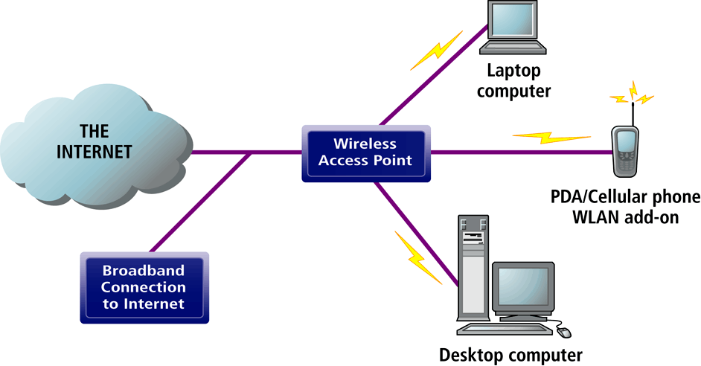
Wireless Local Area Network (WLANs)
Two major technologies: Wi-Fi and Bluetooth
Wi-Fi (802.11)
Wireless standard for Ethernet networks with greater speed and range
(Wireless Fidelity, also known as 802.11b): first commercially viable standard for WLANs
wireless access points connect to Internet directly via a broadband connection and then transmit radio signals to transmitters/receivers installed in laptops or PDAs
Offers high-bandwidth capacity, but limited range; is also inexpensive
Bluetooth (802.11)
Technology standard for short-range wireless communication under 30 feet
personal connectivity technology that enables links between mobile computers, phones, PDAs and connectivity with Internet; has much more limited range than Wi-Fi (30 feet vs. 300 meters, links up to 8 devices)
WiMax (802.16)
Wireless access range of 31 miles

Slide 24
Radio frequency identification (RFID)
Use tiny tags with embedded microchips containing data about an item and location, and antenna
Tags transmit radio signals over short distances to special RFID readers, which send data over network to computer for processing
Active RFID: Tags have batteries, data can be rewritten, range is hundreds of feet, more expensive
Passive RFID: Range is shorter, also smaller, less expensive, powered by radio frequency energy
Common uses:
Automated toll-collection
Tracking goods in a supply chain
Requires companies to have special hardware and software
Reduction in cost of tags making RFID viable for many firms

Slide 25
How RFID Works?
RFID uses low-powered radio transmitters to read data stored in a tag at distances ranging from 1 inch to 100 feet. The reader captures the data from the tag and sends them over a network to a host computer for processing.

Slide 26
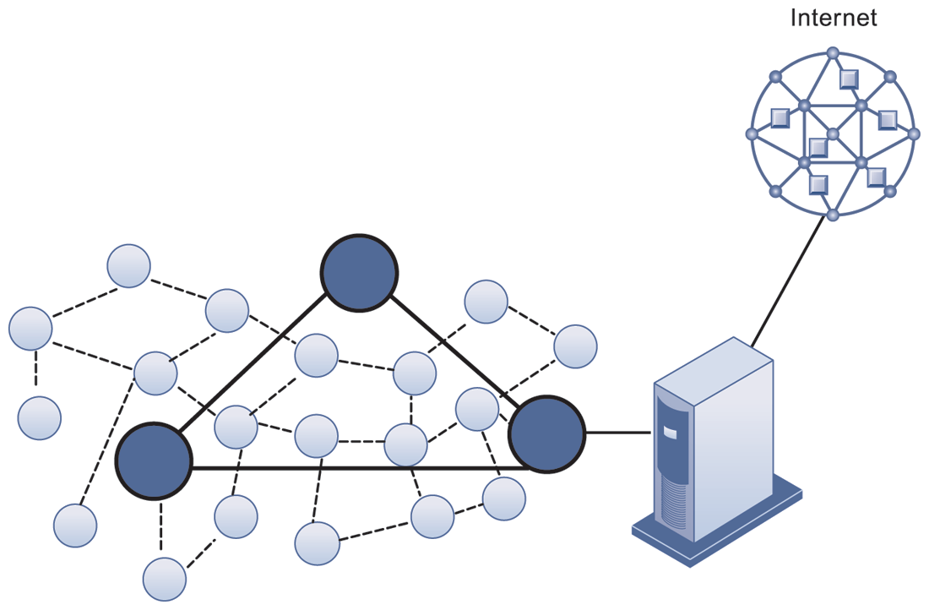
Wireless sensor networks (WSNs)
Networks of hundreds or thousands of interconnected wireless devices embedded into physical environment to provide measurements of many points over large spaces
Devices have built-in processing, storage, and radio frequency sensors and antennas
Require low-power, long-lasting batteries and ability to endure in the field without maintenance
Used to monitor building security, detect hazardous substances in air, monitor environmental changes, traffic, or military activity
The small circles represent lower-level nodes and the larger circles represent high-end nodes.
Lower level nodes forward data to each other or to higher-level nodes, which transmit data more rapidly and speed up network performance.

Slide 27
Question Please
?

