Slide 1
COMB354: Management Information Systems
Exercise 1:
Telecommunications and Network Basics by
Md. Mahbubul Alam, PhD

Slide 2
Learning Objectives
What are the principal components of telecommunications networks and key networking technologies?
What are the types of networks?
How networks are structured?
What are the main telecommunications transmission media and types of networks?

Slide 3
Networking and communication Trends in Today’s Business
  Convergence:
    Telephone networks and computer networks converging into single digital network using Internet standards
    Telephone networks: handled voice communication
    Computer networks: handled data traffic
  Broadband:
      More than 60% U.S. Internet users have broadband access
  Broadband wireless:
      Voice and data communication as well as Internet access are increasingly taking place over broadband wireless platforms
Notes:
This slide discusses recent developments in networking technologies. Ask students to give other examples of convergence. How fast is broadband today? Do all of the students have broadband? Note that in 2000, typical Internet access speeds were 56 kbps over a telephone line, costing 25 cents per kilobit, while today broadband speeds are 1-15 mbps, costing less than 1 cent per kilobit. Are students aware of how fast their Internet connections are at home, school, or work? Ask students if they know the speed of their cell phone’s Internet connection. The point here is to try and raise student awareness of telecommunications systems, and their capacities.

Slide 4
What is a Computer Network?
Set of technologies that connects computers
  Hardware, software and media
Allows users to
  Communicate and collaborate
  Exchange information
  Shared resources in real time
Major components in simple network
  Client computer
  Server computer
  Network Interface Card (NICs)
  Connection medium
  Network Operating System (NOS)
  Hub or switch
  Routers

Slide 5
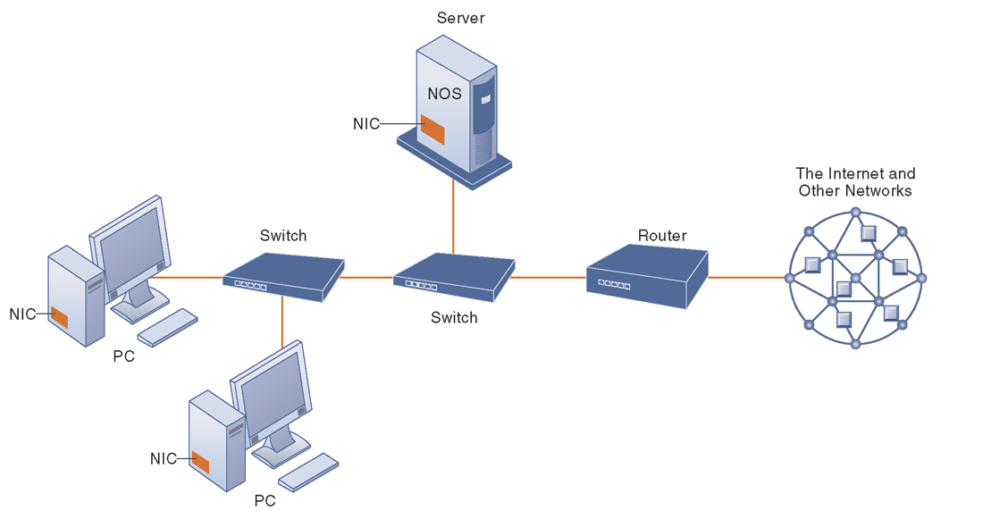
A Simple Computer Network: Components
Server Computer:
A computer on a network that performs important network functions for client computers, such as, serving up Web pages or storing data.
Router:
A communication processor that used to route packets of data through different networks.
Ensure that the data sent gets to the correct address.
Hub/Switch:
Filter & forward data to a specified destination
More intelligence than a hub
Other elements:
Network Interface Card (NIC):
Network Operating System (NOS):
Communication Medium
Notes:
Network interface card (NIC): Every computer on the network contains a Network Interface Card. Most personal computers today have this card built into the motherboard.
Communication medium: telephone wire, coaxial cable, radio signal (for cell phone), Wi-Fi networks
Network Operating System (NOS): routes and manages communications on the Network and coordinates network resources.

Slide 6
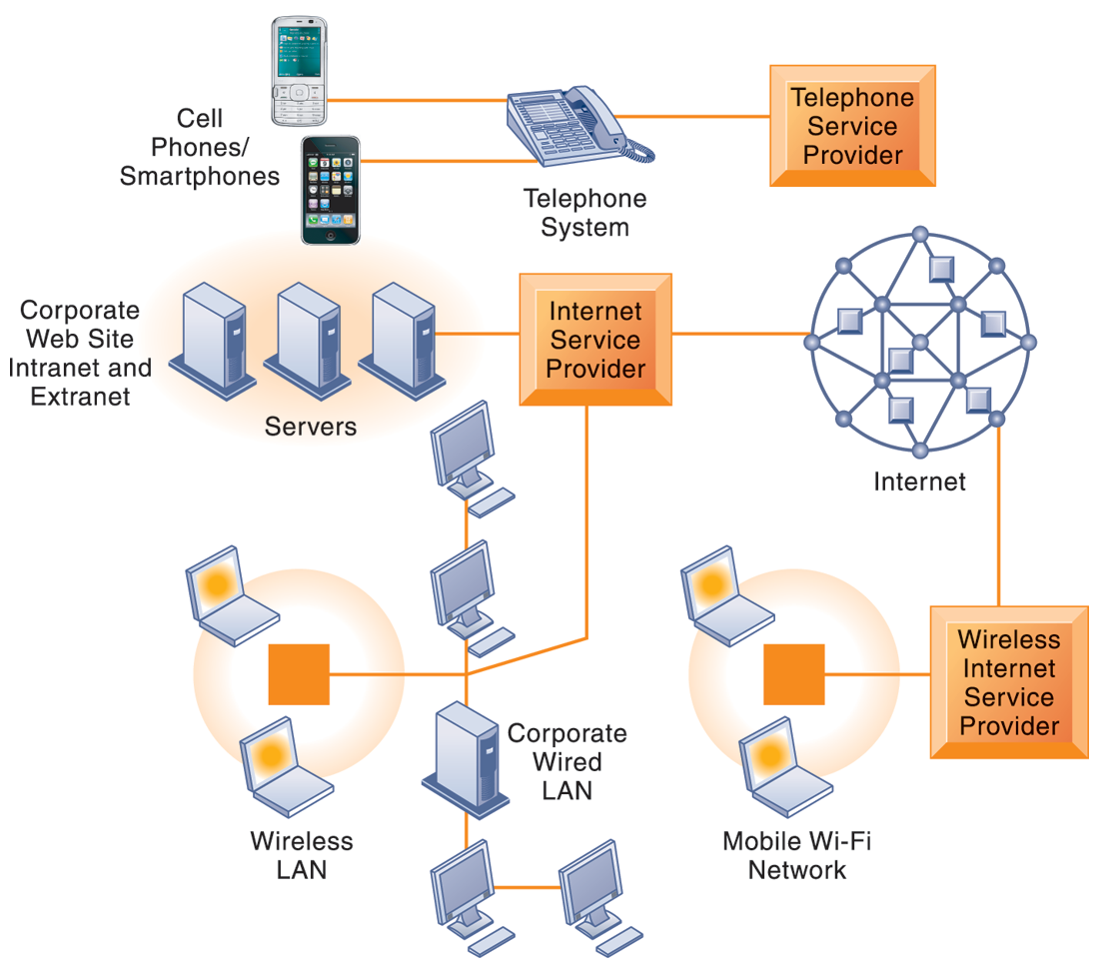
Networks in Large Companies: Components
  Hundreds of local area networks (LANs) linked to firm wide corporate network
  Various powerful servers
      Web site
      Corporate intranet, extranet
      Back-end systems
  Mobile wireless LANs (Wi-Fi networks)
  Videoconferencing system
  Telephone network
  Wireless cell phones
Notes:
Back end systems are corporate systems that are used to run a company such as systems to manage orders, inventory and supply processing. Back end systems support the company's back office. This system collects input from users or other systems for processing.

Slide 7
The Uses of a Network
Simultaneous access to data
  Data files are shared
    Need to installing the programs on physical device is reduced.
    Provide new ways of communication like e-mail, IM.
  Shared files stored on a server
  Software can be shared
    Site licenses
    Network versions
    Application servers

Slide 8
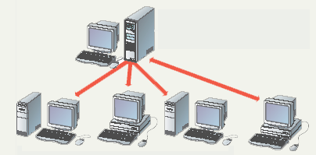
The Uses of a Network (c0nt’d)
Shared peripheral device
  Printers and faxes are common shares
  Reduces the cost per user
  Devices can be connected to the network
  Print servers control network printing
    Manage the print queue

Slide 9
The Uses of a Network (c0nt’d)
Personal communication
  Email
    Instantaneous communication
  Conferencing
    Tele conferencing
    Videoconferencing
    Audio-conferencing
    Data-conferencing
  Voice over IP
    Phone communication over network wires
Easier data backup
  Backup copies data to removable media
  Server data backed up in one step

Slide 10
Types of Networks

Slide 11
Common Network Types
Local Area Network (LAN)
  Contains printers, servers and computers
  Systems are close to each other
  Contained in one office or building
  Organizations often have several LANS
Wide Area Networks (WAN)
  Two or more LANs connected
  Over a large geographic area
  Typically use public or leased lines, e.g., phone lines, satellite
  The Internet is a WAN
Notes:
Teaching tip
Use a real world example to describe an organization with interconnected LANs.

Slide 12
Hybrid Network Types
Campus Area Networks (CAN)
  A LAN in one large geographic area
  Resources related to the same organization
  Each department shares the LAN
Metropolitan Area Network (MAN)
  Large network that connects different organizations
  Shares regional resources
  A network provider sells time

Slide 13
Hybrid Network Types (cont’d)
Home Area Network (HAN)
  Small scale network
  Connects computers and entertainment appliances
  Found mainly in the home
Personal Area Network (PAN)
  Very small scale network
  Range is less than 2 meters
  Cell phones, PDAs, MP3 players

Slide 14
Network Structures

Slide 15
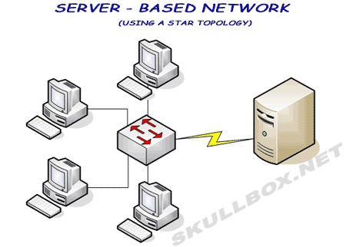
How Networks Are Structured?
Server based network
  Node is any network device or a processing location
  Server-based networks include many nodes and one or more servers.
  The central computer is known as the file server or application server.
  Files and programs used by more than one user (at different nodes) are often stored on the server.
  Servers control what the node accesses
  Users gain access by logging in
  Server is the most important computer
Notes:
Dumb terminal. Device with a monitor and keyboard but no central processing unit (CPU).

Slide 16
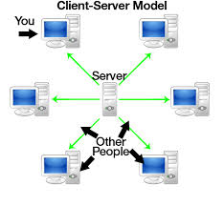
How Networks Are Structured? (cont’d)
Client/Server network
  Nodes and servers share data roles
  Nodes are called clients
  Servers are used to control access
  Database software
    Access to data controlled by server
  Server is the most important computer

Slide 17
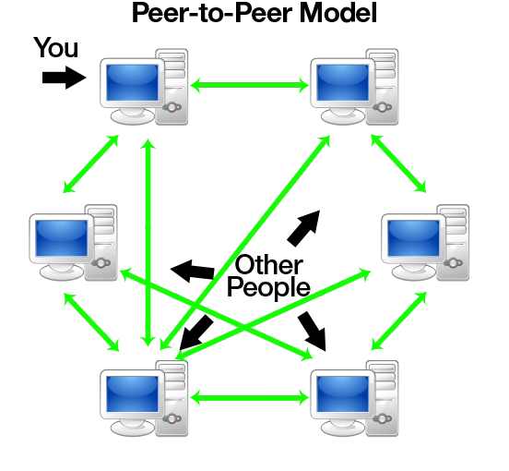
How Networks Are Structured? (cont’d)
Peer to peer networks (P2PN)
  All nodes are equal
  Nodes access resources on other nodes
  Each node controls its own resources
  Most modern OS allow P2PN
  Distributing computing is a form
Notes:
Teaching tip
Discuss how users managing their own security settings can be bad.

Slide 18
Network Typology

Slide 19
Network Topologies
Topology
  Logical layout of wires and equipment
  Choice affects
    Network performance
    Network size
    Network collision detection
  Several different types
Notes:
Teaching tip
Discuss how your network topology handles collisions. If your students are technical, contrast this with an inferior topology.

Slide 20
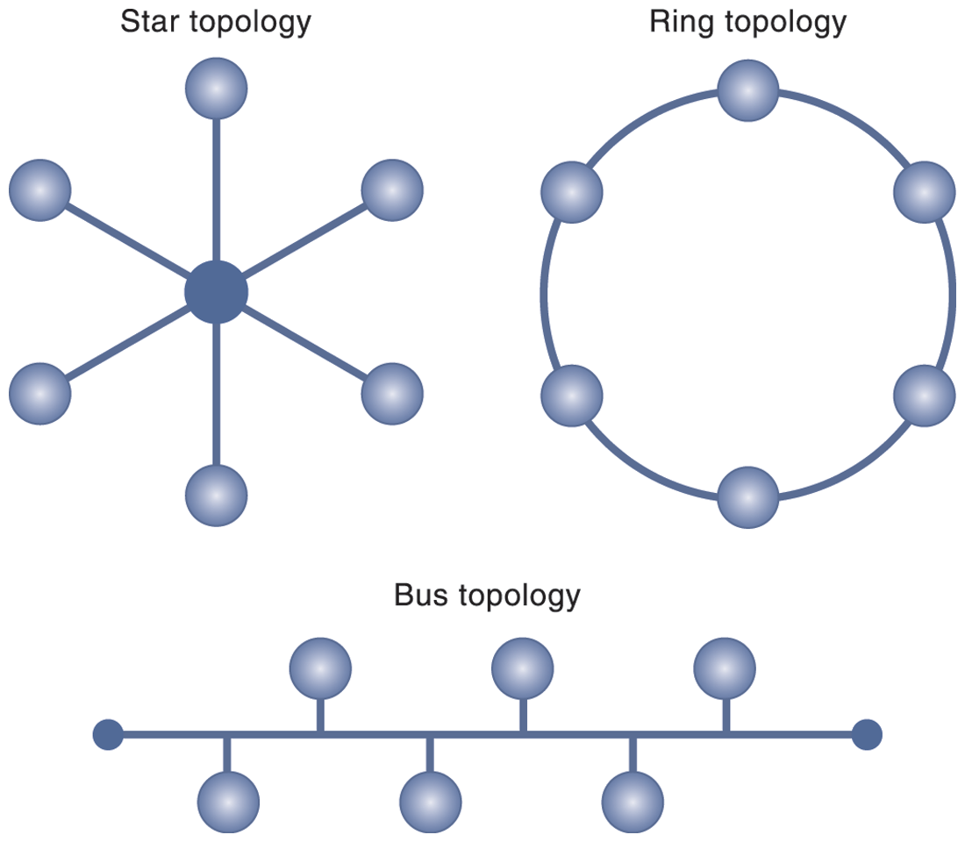
LAN Typologies: Types
Star topology:
  All devices on the network connect to a single hub and all network traffic flows through the hub.
  In an extended star network, multiple layers or hubs are organized into a hierarchy.
Bus topology:
One station transmits signals, which travel in both directions along a single transmission segment.
All of the signals are broadcast in both directions to the entire network.
All machines on the network receive the same signals, and software installed on the client’s enables each client to listen for messages addressed specifically to it.
Ring topology
Connects network components in a closed loop.
Messages pass from computer to computer in only one direction around the loop, and only one station at a time may transmit. The ring topology is primarily found in older LANs using Token Ring networking software.
Notes:
Star typology: One malfunction node doesn’t affect the rest of the network (advantage). If main or central computer fails, the entire network becomes unusable (Dis-adv).
Bus: Adv: easy to connect, require less cable. Dis-adv: entire network will shut down if there is a break in the main wire and difficult to find the problem.
Ring: dis-adv: old, close loop,

Slide 21
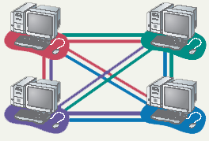
LAN Typologies: Types (cont’d)
Mesh topology
  All computers connected together
  Internet is a mesh network
  Advantage
    Data will always be delivered
  Disadvantages
    Lots of cable
    Hard to setup

Slide 22
Data Transmission

Slide 23
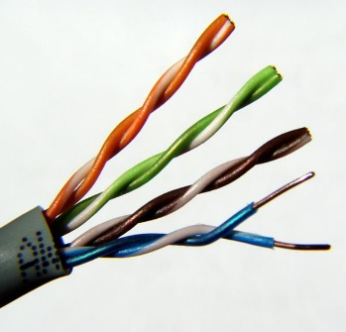
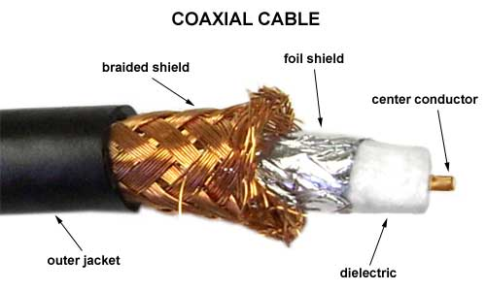
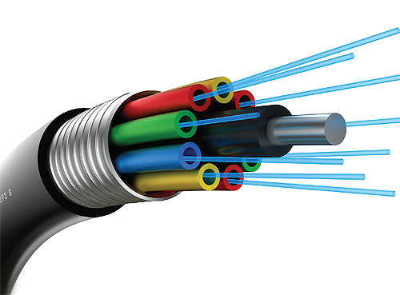
Physical Transmission Media
  Twisted wire
    Strands of copper wire twisted in pairs,
    e.g., CAT5 (up to 1 Gbps), used in today’s LANs
    Limited to maximum 100 meters (328 feet)
  Coaxial cable
    Similar to that used for cable television
    Thick insulted copper wire than can transmit a larger volume of data than twisted wire.
    More than 100 meters.
  Fiber optics and optical networks
      Consists of bound strands of clear glass fiber, each the thickness of a human hair.
      Data are transformed into pulses of light sent by a laser device.
      Considerably faster, lighter, more durable.
  Wireless transmission media and devices
      Microwave
      Satellites
      Cellular telephones
Notes:
1. Microwave: High frequency radio signals. It follows a straight line and do not bend with the curvature of the earth. Therefore, long distance terrestrial transmission systems require that transmission stations be positioned about 37 miles apart.

Slide 24
Physical Transmission Media (cont’d)
Transmission Speed
  Hertz
    The total amount of digital information that can be transmitted through any telecommunications medium is measured in bits per second (bps).
    One signal change, or cycle, is required to transmit one or several bits, therefore, the transmission capacity of each type of telecommunications medium is a function of its frequency.
    The number of cycles per second that can be sent through that medium is measured in hertz-one hertz is equal to one cycle of the medium.
  Bandwidth
    Measured how much data can be transferred over a communication medium within a fixed period of time.
    The range of frequencies that can be accommodated on a particular telecommunications channel is called its bandwidth.
    The bandwidth is the difference between the highest and lowest frequencies that can be accommodated on a single channel.
    The greater the range of frequencies, the greater the bandwidth and the greater the channel’s transmission capacity.

Slide 25
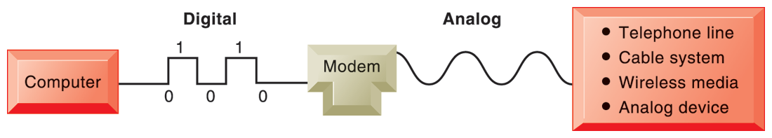
Signals: Digital Vs. Analog
Analog signal
  A continuous waveform that passes through a communications medium and has been used for voice communication.
  Most common analog devices, such as, telephone handset, computer speaker, iPod earphone
Digital signal
  A discrete, binary waveform RATHER than a continuous waveform.
  Communicate information as strings of two discrete states: one bit or zero bits (i.e., on-off electrical pulses).
  Computers use digital signals, and require a modem to convert these digital signal to analog signals that can be sent over (or received from) telephone lines, cable lines, or wireless media that use analog signals.

Slide 26
Key Networking Technologies

Slide 27
Key Networking Technologies
Key Technologies: Three
  Client/server computing
  Packet Switching
  Transmission Control Protocol/Internet Protocol (TCP/IP)
    The most important technology
    Linking disparate networks and computers
    Widely used as Internet Communication Standards

Slide 28
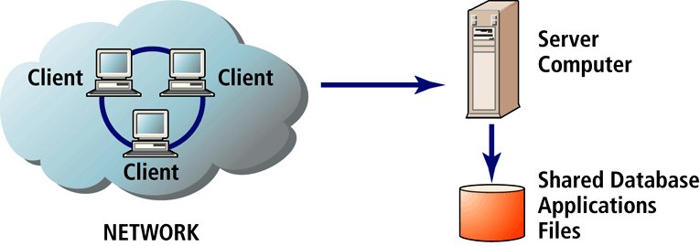
Client/Server Computing
Client/Server Computing
  A model of computing in which very powerful personal computers (clients) are connected in a network with one or more server computers that perform common functions for the clients, such as storing files, software applications, etc.
Client
  A powerful personal computer that is part of a network.
Server
  Networked computer dedicated to common functions that the client computers on the network need.
Notes:
1. The New client is The Mobile Platform

Slide 29
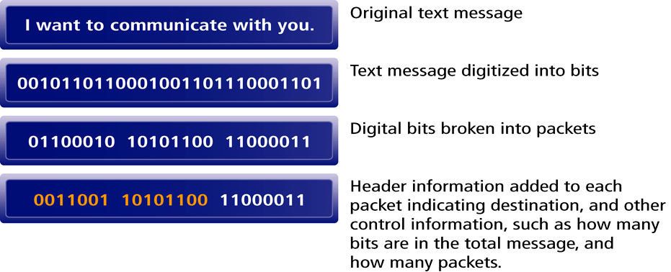
Packet Switching
    A method of slicing digital messages into packets, sending the packets along different communication paths as they become available, and then reassembling the packets once they arrive at their destination.
    Uses routers: special purpose computers that interconnect the computer networks that make up the Internet and route packets to their ultimate destination.
    Routers use computer programs called routing algorithms to ensure packets take the best available path toward their destination.

Slide 30
Transmission Control Protocol/Internet Protocol (TCP/IP)
    Protocol: A set of rules for formatting, ordering, compressing and error-checking messages.
    TCP: Establishes the connections among sending and receiving Web computers, handles the assembly of packets at the point of transmission, and their reassembly at the receiving end.
    IP: Provides the Internet’s addressing scheme
TCP/IP is divided into four separate layers.
  Network Interface Layer,
    placing packets on & receiving them from the network medium, e.g., LAN (Ethernet), other network.
  Internet Layer,
    addressing, packaging & routing messages on the Internet.
  Transport Layer,
    providing communication with the application by acknowledging & sequencing the packets to & from the application.
  Application Layer,
    provides a wide variety of application with the ability to access the services of the lower layers.
    e.g., HyperText Transfer Protocol (HTTP), File Transfer Protocol (FTP), Simple Mail Transfer Protocol.

Slide 31
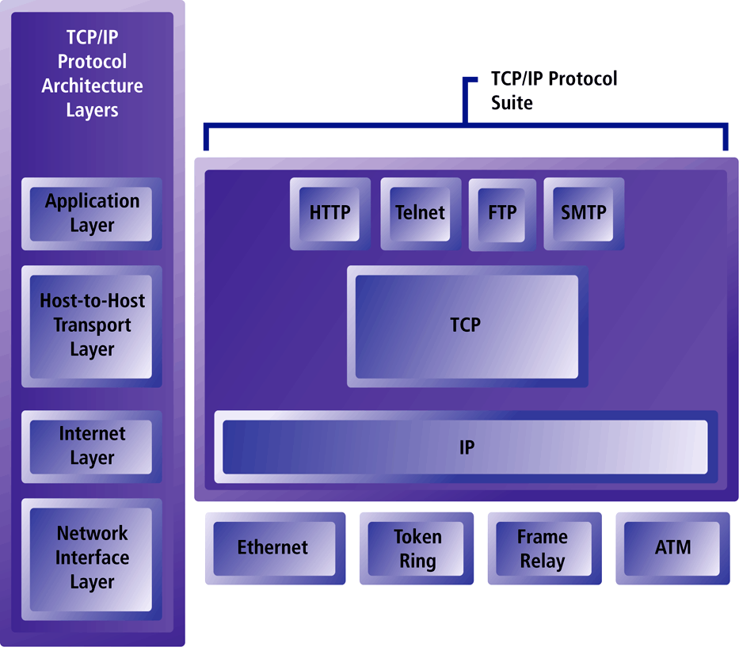
TCP/IP Architecture

Slide 32
IP Address
Two versions of IP currently in use.
IPv4 Internet address (also called IP address):
A 32-bit number expressed as a series of four separate numbers marked off by periods, such as 64.49.254.91
Each of the four numbers can range from 0-255.
IPv4 the current version of IP. Can handle up to 4 billion addresses
IPv6 (next generation of IP) will use 128-bit addresses and be able to handle up 1 quadrillion addresses.
Notes:
64.49.254.91 → first three sets of numbers (64.49.254) identifies the Network (Local Area Network Identification) and last number (91) identified a specific computer.
1 million = 10⁶, 1 billion = 10⁹ , 1 Trillion = 10¹² , 1 Quadrillion = 10¹⁵

Slide 33
Internet Protocols and Utility Programs
HTTP (HyperText Transfer Protocol): Protocol used to transfer Web pages
SMTP (Simple Mail Transfer Protocol), POP (Post Office Protocol) and IMAP (Internet Message Access Protocol): Protocols used to send and receive e-mail
FTP (File Transfer Protocol): Protocol that permits users to transfer files from server to client and vice versa. One of the original Internet service. Transfer file from computer to computer.
SSL (Secure Sockets Layer/TLS (Transport Layer Security): Protocol that provides secure communications between client and server
Telnet: Logging on to one computer system and doing work on another.
Finger: Utility program that lets you check who is logged on, for how long and user name
PING: Utility program that allows you to check connection between client and server
Tracert: Utility program that allows you to follow path of a message sent from a client to a remote computer
Notes:
HTTP → HyperText Transfer Protocol. SMTP: Simple Mail Transfer Protocol, POP → Post Office Protocol, IMAP→ Internet Message Access Protocol. FTp → File Transfer Protocol, SSL → Secure Sockets Layer (SSL)/Transport Layer Security (TLS)
Utility program: PING → Packet InterNet Groper,

Slide 34
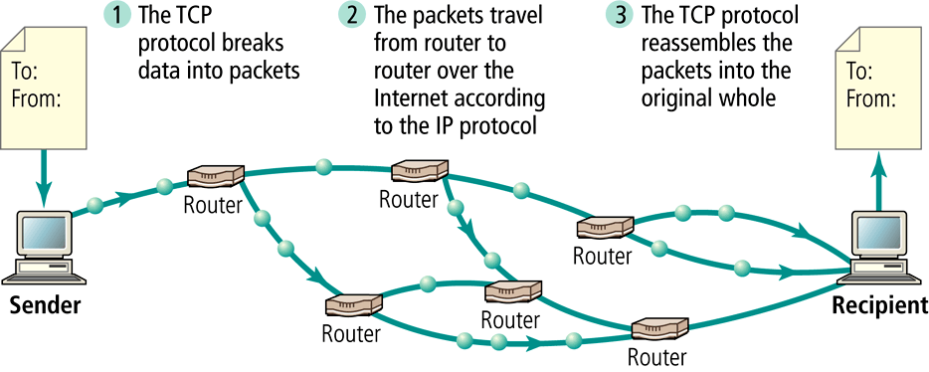
Routing Internet Messages: TCP/IP & Packet Switching
The Internet uses packet-switched networks and the TCP/IP communications protocol to send, route & assemble messages.
Messages are broken into packets, and packets from the same messages can travel along different routes.

Slide 35
Question Please
?

