Slide 1
AEIS 355 Rural Sociology & Psychology
Md. Mahbubul Alam, PhD
Professor
Dept. of AEIS

Slide 2
Topics to be covered…………
Rural Sociology: What & Why?
Introduction to Psychology
Society & Community
Concept & Characteristics
Social Change
Socialization Process
Behavior
Concept & type
Element & Model
Frustration
Personality
Concept & theories of personality

Slide 3
1. Rural Sociology What & Why?

Slide 4
Sociology
Sociology
Sociology
Sociology

Slide 5
Sociology
Study of society on a highly generalized or abstract level
“Science of Society”
Sociology
Socio logy
(Latin) Refers to society
Sociology
(Greek) Study on a high level

Slide 6
Sociology (Cont’d)
Sociology is the study of
Groups or social system
Social relationships
Human interactions & interrelations, their conditions & consequences
Social action
Social phenomena
Sociology is the systematic study of social institutions, their nature, functions & interactions, sequences of continuity and change.

Slide 7
What is Rural?
An area which is dominated by extensive land uses, notably agriculture and forestry.
Population or statistical definition: An area which has fewer than 2,500 residents (US Census Bureau, 1950)
Persons who live in the country or towns of less than 2,500 population are said to be rural.
Practice of Agriculture: Agricultural production and landscape
Administration definition: An area that is not the capital or center is considered rural.

Slide 8
Rural Sociology is therefore…….
One of several subfields of sociology
Scientific study of rural people in group relationships
More often applied to the solution of social problems because its focus on social change and problems.

Slide 9
History of Rural Sociology
1900
First Sociology dept. was founded by University of Chicago
Identified social problem resulting from industrialization, urbanization, & other social changes
1910
Country Life Commission created by US President Theodore Roosevelt
Identified main social problems of rural America and hired groups to perform rural social surveys
1937
First Journal of Rural Sociology had been published
Fostered the emergence of rural sociology as problem-oriented and applied study

Slide 10
Why Study Rural Sociology?
About 4 out of 5 people live in rural areas
World’s population is much more heavily rural especially in the developing country
It’s not only studied farmers but also rural nonfarm people who live in rural areas
Despite the size of farm lands are decreasing, the quantity of farm resources (e.g., machinery, fertilizer, livestock) are increasing
Therefore, there is a need for extension workers, agricultural engineers, agribusiness

Slide 11
Uses of Rural Sociology
Extension Service
Need Assessment Studies
Social Impact Studies
Environmental Studies
Development and Poverty Studies

Slide 12
Rural Sociology & Agril. Extension: Linkage
Both are studied rural life
Rural sociology is the scientific study of the interaction and interrelationship of rural people with others whereas extension teaches rural people to be enabled them to achieve desirable outcomes and thus fosters development of the rural society.
The former studies attitude and behavior of rural people and the latter studies to modify or change the attitude and behavior of farmers.
Rural sociology studies the needs and interests of rural society and extension helps farmers to discover their needs, problems and solutions.
Rural sociology analyses rural social relationship or group or organization leaders while extension utilizes the knowledge pertaining to group, organization and leaders for agricultural development.
Rural sociology studies social situations and collects social facts and extension makes uses of social data as basis for formulating programme for agricultural development.

Slide 13
2. Social Psychology

Slide 14
Social Psychology
Influence of social processes on the way people:
Think
(thoughts; cognition)
Feel
(feelings; emotions)
Behave
(behavior; actions)

Slide 15
Domains of Social Psychology
CULTURE & ENVIRONMENT
OTHERS
SELF

Slide 16
Scope of Social Psychology

Slide 17
Focus of Social Psychology
Leadership
Relationships
Intergroup Relations
Social Influence

Slide 18
Why Study Psychology in Agril. Extension?
Interpersonal relationships and cultural competence
Help to understand interpersonal attitudes, social interaction and interposal communication
Group processes and cooperative behaviors
Extension practice takes place in the context of group or collection settings (e.g. 4-H Club)
Psychological knowledge in relevant for dealing with issues such as group leadership, cooperative behaviors, conflict management.
Learning processes and human resource development
Extension is essential a process of nonformal education.
Psychology seems relevant to understanding and facilitating various different learning processes from adult education, on-the-job training to social learning.
Participation, engagement and ownership
Stakeholders participation are vital for the sustainability of all development programs.
Community psychology helps to understand people’s participation, engagement, motivation and ownership which are fundamental needs for extension services.

Slide 19
Why Study Psychology in Agril. Extension? (Cont’d)
Technology adoption, behavioral change and innovation processes
The most contribution of psychology to extension is technology adoption.
Plus, contribute widely to study and understand the processes of social change.
Evaluation and accountability
Psychology may help to generate new indicators to measure the success of extension interventions such as self-esteem, quality of life, community trust rather than the traditional measures of satisfaction and technology adoption.
Reflection on practice and continuous innovation
Organizational psychology explains how organizational learning and innovations occur which could help extension organizations to become vigilant and reflect on their existing service so as to foster individual learning and institutional innovations.
Ref. Landini, Mendez & Hegedus (2017)

Slide 20
Three Themes
Social Thinking
How we think about others, e.g., Attributions
Social Influence
How we are influenced by others, e.g., Conformity
Social Relations
How we interact with others, e.g., Relationships

Slide 21
a. Social Thinking

Slide 22
Social Thinking
Attribution
Attitude Behavior
Cognitive Dissonance

Slide 23
Attribution
We are all “intuitive scientists’ or ‘naïve psychologists’!!!
Observed Behavior
“Process of inferring the causes of mental states, behaviors, and events which occur to ourselves & others” (Heider, 1958)
‘Supervisor yells at everyone…..because he is a hostile person’.
(Behavior reflects the ‘person’)
‘Supervisor yelled at me….because I missed the project deadline’.
(behavior is due to ‘situation’)
Internal (Dispositional)
Explanation
External (Situational)
Explanation
Notes:
Attribution=> How we explain other people’s behavior OR, the action of regarding something as being caused by a person or thing.

Slide 24
Attribution biases
Fundamental Attribution Error (FAE)
Actor-Observer Bias
Opposite is happened when we explain our own behavior.
People are more likely blame external forces rather than own personal characteristics.
When people know more about the personality and behavior of a person, they are better able to understand his view and more able to be aware the situational forces for his behavior.
Correspondence bias
Overestimate internal factors (e.g. personality) more than external factors (e.g. environment)
Even though situational variables are very likely present, people tend to attribute the cause to internal factors.
People tend to blame others while the person is completely innocent but becomes a victims of crimes for his misfortune.

Slide 25
Attitude & Behavior
Behavior
Attitude:
Valenced (+/-) beliefs & feelings towards people, objects, & events, e.g.,
Donald Trump?
GM food?
Attitudes are specific & relevant to behavior
Attitudes are implicit (unconscious)
Attitude
Situation
Behavior also influences Attitude
“What we do, we gradually become”
Environmental reinforcement matches attitude

Slide 26
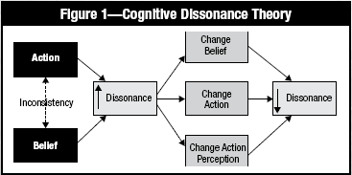
Cognitive Dissonance (Festinger)
‘I know using chemical fertilizers adversely affects environment (attitude), yet use regularly for my farming (behavior)’

Slide 27
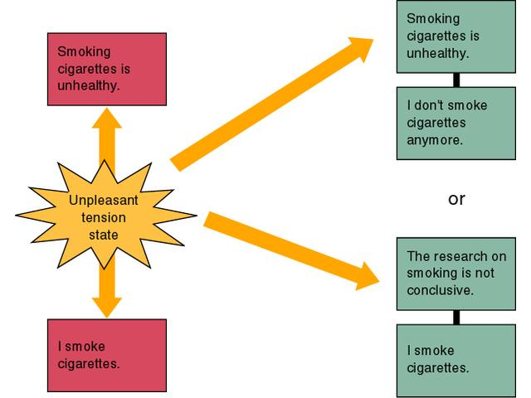
Cognitive Dissonance Model
Two inconsistent cognitions -> Dissonance
An attitude
A counter-attitudinal behavior
Motivation to reduce dissonance
Change Attitude or justify counter-attitudinal behavior

Slide 28
b. Social Influence

Slide 29
Social Influence
The greatest contribution of social psychology is its study of attitudes, beliefs, decisions and actions and the way they are moulded by social influence.
Conformity
Obedience
Group influence

Slide 30
Conformity
A person’s desire to gain approval or avoid rejection
Willingness to accept others’ opinion about reality
Adjusting one’s behavior or thinking to coincide with a group standard
Normative Social Influence
Conformity
Informational Social Influence
e.g., Solomon Asch Studies (1950)
Group may provide valuable information
When task is difficult or you are unsure, it makes sense to listen to others

Slide 31
Obedience
People comply to social pressures
Milgram studied the effects of authority on obedience (Stanley Milgram)
63% complied with administration of shocks
Degree of obedience influenced by
Physical proximity of authority figure
Status of authority figure
Depersonalization of victim
Lack of defiant role models
Notes:
Milgram used Shock Levels in Volts

Slide 32
Obedience (cont’d)
Zimbardo’s Prison Study (1971)
Explain behavior in terms of environmental factors
Experiment
Subjects played either prisoners or guards
Prisoners were arrested, fingerprinted, dressed, referred by numbers
Guards were dressed and give control over prisoners
Subjects became their roles in action, thought and feeling.
Situation made people act the way they do rather their disposition (personality)

Slide 33
Group Influence
Social facilitation, a tendency for people to perform differently when in the presence of others than when alone.
Social loafing, a tendency of individuals to put forth less effort when they are part of a group.
Deindividuation, a psychological state in which a person has a reduced sense of individuality and personal responsibility due to the anonymity of being in a crowd of people.
Group polarization, a phenomenon wherein the decisions and opinions of people in a group setting become more extreme than their actual, privately held beliefs.
Groupthink, a phenomenon that occurs within a group of people in which the desire for harmony or conformity in the group results in an irrational or dysfunctional decision-making outcome.

Slide 34
c. Social Relationship

Slide 35
Social Relationship
Prejudice, unjustifiable or prejudgment attitude toward a group and its members.
Components: beliefs (stereotypes), emotions (hostility, envy, fear), predisposition to act (to discriminate)
Aggression, physical or verbal behavior intended to hurt or destroy.
Emerges from the interaction of Biology (genetic, neural, biochemical) and Experience ((aversive events, e.g., misery, temp, frustration), operant conditioning, social learning)

Slide 36
Social Relationship (cont’d)
Attraction -> proximity, attractiveness, similarity
Love-> Passionate, aroused state of absorption (arousal + cognition), Companionate (deep affection & caring)
Altruism, intentional behavior that is intended to benefit welfare of others.
Altruism is often for self-benefit e.g., power, status, reward, psychological gain, equity/reciprocity, social responsibility norm.

Slide 37
Social Relationship (cont’d)
Bystander Effect, diminished sense of personal responsibility to act because others are seen as equally responsible.
Bystanders are less likely to help in presence of more people (e.g., part of a large crowd)
75% help when alone vs. 53% in presence of others

Slide 38
3. Society & Community

Slide 39
Community
‘com’
together
Community
Serve together
‘munis’
serve
A community is a collection of inter-dependent people with residential ties to a particular locality.
Something in common, such as, norms, religion, values, identity or often share a sense of place

Slide 40
Territory
For most instances, a society has its own formal boundaries and territory that the world recognizes them.
However, it does not have to be a geopolitical borders.
Society
A group people with common
Interaction
Members must come in contact with one another.
Without having regular contact, groups might not considered as part of same society.
Reason: Geographical distance and language barrier.
Culture
Language, values, beliefs & behavior that affect one’s way of life.
People of a society share same aspects of their culture.

Slide 41
Society: Types
Types of society | Characteristics
Hunter-gatherer | Primarily or exclusively based on hunting wild animals, fishing, and gathering wild fruits, berries, nuts and vegetables. Non-hierarchical social structure e.g., Sentinelese of the Andaman Islands
Pastoral | Primary means of subsistence is domesticated livestock. Nomadic, move seasonally in search of fresh pastures and water. e.g., Bedouins of Northern Africa and Middle East
Horticultural | Primary means of subsistence is the cultivating crops using hand tools. No use of mechanized tools or no use of animals to pull plows. e.g., Incan empire of Peru
Agricultural | Primary mode of production is agriculture which uses plows and draft animals to cultivate food. e.g., American South, pre-Civil War
Industrial | A society based on mechanical labor as opposed to manual labor to create material goods. e.g., 19th & 20th century United States & Western Europe
Postindustrial | Primary means of subsistence is derived from service-oriented work, as opposed to agriculture or industry. Information, knowledge, and creativity are seen as the new raw materials of the economy. e.g., Modern society

Slide 42
Topographical
Includes land, water & climate
Fertile land, good climate & water attracted more people
Economic
Favorable agricultural conditions
Growth of Rural Community:
Factors
Social
Ecological
Population, occupation, distance from the town, etc.

Slide 43
Rural vs. Urban
Relative isolation of the country life
Difference in the mode of occupation
Simplicity vs. complexity
Associative individualism vs. persistent traditionalism
Intensity of community sentiment in city & country
Cultural contrasts and relationship between city and country

Slide 44
Social Change

Slide 45
Any significant alternation over time in behavioral patterns, culture, values and norms
Change in:
Structure & functioning of a social system
Roles individuals perform
Values and norms
Social relationships among people
Pattern of social interaction
Functions performed by different groups and institutions
Nature of Social Change:
Change that can affects the bulk of the community.
It is a universal process.
Often do not depend on the willingness of the society & its members
Speed of social change differ from society to society
Social changes have both qualitative and quantitative aspects.
Change is NOT synonymous with development.
Both internal and external factors are responsible for social change.
Social Change
Factors for social change
Natural factors
Geographical factors
Cultural factors
Population factors
Psychological factors
Biological factors
Technological factors
Notes:
Speed of change in tribe and rural society is lowers than that of contemporary societies.
Quantitative change: increase in number of household, qualitative change: composition and roles of households.

Slide 46
Pattern of Social Change
Patterns | Example
Social Change through Evolution | Social change is like an evolutionary change which occurs due to internal forces within society. e.g., Darwin, Herbert Spencer Hunters-> fruits pickers->shepherd-> agriculture->industrial
Social Change through Progress | “going forward”- towards positive direction. Progress can be visualized, indicates very definite direction of change. Change caused due to external forces.
Social Change through Development | The speed at which a stage changes or develops over into another stage. A change from one stage to the next is development.
Social Change through Revolution | Comes only as a new big all-round change that takes place against the existing social stage. e.g., Karl Marx and his followers.
Social Change through Social Movement | Actions or endeavors that are undertaken to eradicate evil social customs, religious misbelieves, cultural and social discriminations.

Slide 47
Socialization Process

Slide 48
Socialization Process
The process whereby an individual learns to adjust to a group (or society) and behave in a manner approved by the group (or society).
The whole process of learning throughout the life course and is a central influence on the behavior, beliefs and actions.
Four stages:
The Oral Stage
The Anal Stage
The oedipal Stage
The stage of Adolescence

Slide 49
Socialization Process (Cont’d)
Begins with the birth and continues up to one year
By crying, child establishes oral dependency
Develop definite expectations about the feeding time.
Stage of primary identification-> merges identity with mother.
Period: fourth year to puberty (12/13 years)
Becomes the member of the family as a whole.
Identify himself with the social roles.
Child is able to understand the sexual difference
Internalizes clearly his roles.
Oral Stage
Anal Stage
Oedipal Stage
Adolescence
Stage
Period: First year to third year
Child learns that he cannot depend entirely on his mother.
Learn some degree of self controlling, e.g., toilet training.
Distinguishes between correct and incorrect actions (reward/punishment)
Boys and girls try to become free from paternal control.
Experience a kind of strain or conflict.
Free in doing activities but parents continue to control many activities.
Accept responsibility and learn new social roles.

Slide 50
4. Behavior

Slide 51
Capacity of mental, physical, emotional, & social activities experienced during five stage of human’s life- prenatal, infancy, childhood, adolescence & adulthood.
Dictated by culture, society, values, morals, ethics and genetics.
Why we study this?
To understand why people behave in a particular way (optimistic vs. pessimistic)
To understand individual differences (no two people behave in a same way)
To understand various internal processes
To understand why people work (work for money, work for satisfaction)
To study the changes in organization
Human behavior is adaptive or maladaptive
Human Behavior
“The manner in which one acts or behaves”
Every human being is different yet the same
Dimension of human behavior
Primary -> personal characteristics, e.g., prejudices, stereotypes
Secondary-> Characteristics that people acquire throughout their lives, e.g., family, education, work style

Slide 52
Comes from genetic process from parents or blood relations, e.g., intelligence, stature, emotion, glands, physical appearance.
Genetic or inherited element
Intelligence-> helps people to adjust with the environment properly.
Stature-> tallness. Some activities are designed for tall people.
Emotion-> Complex neurological expression helps people to motivate toward his activities.
Physical Appearance, like height, strength, health condition, color, weight etc. plays important role to shape his behavior.
Glands
Adrenal glands-> produce hormones (e.g., cortisol & aldosterone), controls blood pressure & sugar, burns protein & fat, react to stressors like injury
Thyroid glands -> controls metabolism, regulate body functions like breathing, heart rate, nervous system, body weight, etc.
Pituitary -> ‘master gland’, controls other glands
Basic Element of Behavior
Social Elements
Geographical elements
Behavior is differentiated due to geographical location of individuals.
Climate, land topography, natural resources & minerals, rivers & mountains, etc. influence individual behavior.
Family, school, culture, social organizations, religious organization impact individual behavior

Slide 53
Theories of Human Behavior

Slide 54
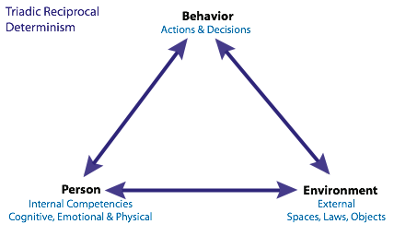
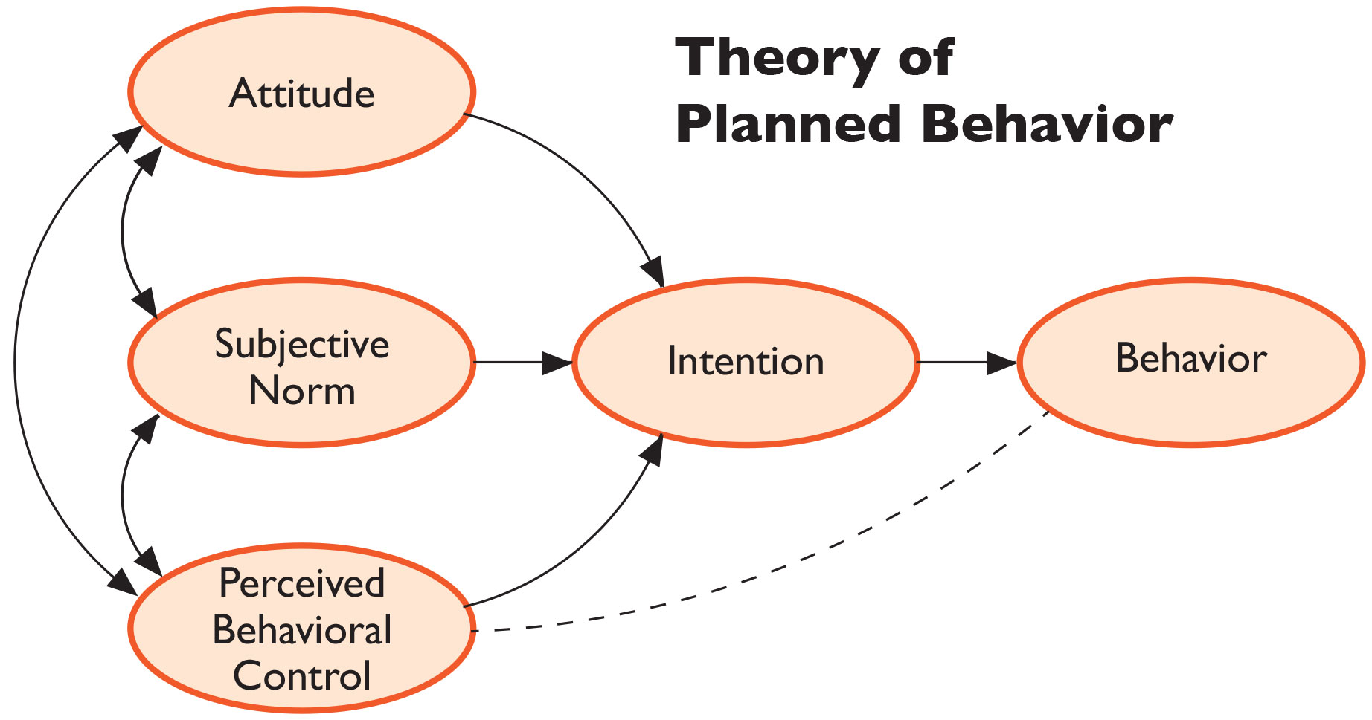
Social Cognitive Theory (SCT) (Bandura, 1989), explains human behavioral model in which personal factors, environmental influences & behavior continually interact.
The basic premise of SCT is that people learn not only through their own experiences, but also by observing the actions of others and the results of those actions.
TPB (Ajzen, 1985), an extension of TRA.
The basic premise of TPB is that attitude towards behavior, subjective norm and perceived behavioral control, together shape an individual’s behavioral intention and behavior.

Slide 55
Molar behavior, behavior which is purposively predetermined, e.g., infected fields and farmer’s action to control pest.
Overt behavior, behavior which can be observed and feel extremely through observation.
Based on motive
Based on observation
Covert behavior, behavior which cannot be externally seen or observed but is happening inside individuals.
Molecular behavior, behavior which is not predetermined but to adjust with the instant situation.
Type of human behavior
Conscious behavior, any behavior that a person is aware of, e.g., walking, eating.
Based on person’s
awareness
Unconscious behavior, any behavior that the person is not aware of, e.g., biting fingers, shaking legs

Slide 56
Reactions to frustration:
Aggression/anger
Apathy
Reduced level of goals
Withdraw
Compromise
An emotion that an individual feels when a goal cannot be achieved or fulfilled.
Obstacle
Person
Goals
Frustration
Reasons:
Accident
Absence of love & tolerance
Conflict of motives

Slide 57
5. Personality

Slide 58
Origin:
Latin word, ‘Persona’ -> disguise
Characteristics which differentiate one person to another.
What we are?
Personality is a patterned body of habits, traits, attitudes and ideas of an individual as these are organized externally into roles & statues and as they relate internally to motivation, goals and various aspects of selfhood.
Total quality of an individual’s behavior
What do we do?
What do we have?

Slide 59
Theories of Personality

Slide 60
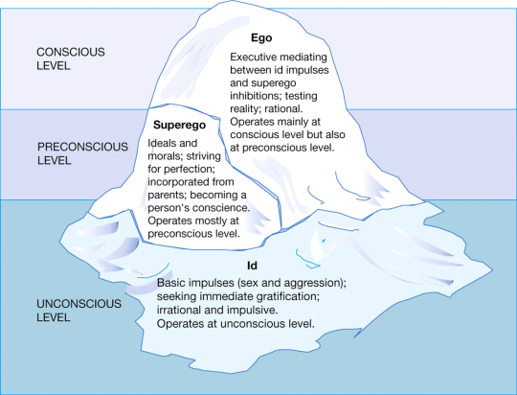
ego: Reality principle, the idea that the desire of the id must be satisfied in a method that is both socially appropriate and realistic; sense of self realistic; works as intermediary between id and superego
L1: Your current state of awareness.
superego: Ego ideal, your view of what is considered wrong; control of impulse, conscience; Polar opposite of id; internal representation of all of society’s rules, morals, and obligations
L2: All information that your are not currently aware of but that can be recalled (e.g., knowledge, memory)
id: Pleasure principle, the idea that all of your needs should be met immediately, e.g., impulse, desire, pleasure
Psychoanalytic Theory
(Sigmund Freud)
L3:Outside of your awareness at all times.

Slide 61
A person might be specifically known for these traits, e.g., greed, kindness, narcissism.
Cardinal traits
They often become synonymous with the names of the person.
Trait Theory
(Gordon Allport, 1936)
Trait is a stable characteristic that causes a person to depict a response to any situations in certain ways.
Traits are always constant regardless of the situations.
Central traits
Secondary traits
Major characteristics of a person are referred as central traits.
The characteristics that lead to the foundation of an individual's personality, e.g., anxious, intelligent, dishonest.
A general behavior patterns that only appear under certain circumstances, e.g., getting nervous to speak in public.

Slide 62
Shyness to sociability
Introversion:
closed off, sky, less social, less comfortable to talking new people
Introversion/Extroversion
Extroversion:
More outgoing, social, more open to new experience.
Neuroticism:
instability of emotions, causing a person to become upset or emotional.
Strongly emotional, show signs of excessive stress
Hans Eysenck’s Personality Model
Psychoticism:
This trait suggests that the individual might not be normal & might have trouble dealing with reality.
Hostile, non-empathetic, manipulative and antisocial
Neuroticism/Emotional Stability
Psychoticism
Emotional stability:
the state of being emotionally stable or constant
Persons ability to stay calm during unexpected events

Slide 63
Raymond Cattell’s Trait Theory
Surface traits: clusters of related behaviors observed in a given situation; easily visible traits to any observer.
Source traits: underlying structures responsible for the surface traits, sixteen basic dimensions were identified which are the root of all behavior.
Reserved | Outgoing
Less intelligent | More intelligent
Affected by feelings | Emotionally stable
Submissive | Dominant
Serious | Happy-go-lucky
Expedient | Conscientious
Timid | venturesome
Tough-minded | sensitive
Trusting | Suspicious
Practical | Imaginative
Forthright | Shrewd
Self-assured | Apprehensive
Conservative | Experimenting
Group dependent | Self-sufficient
Uncontrolled | Controlled
Relaxed | tense

Slide 64
Big Five Factors of Personality (Goldberg, 1991)
Neuroticism
The tendency to be depressed, anxious, insecure, vulnerable, & hostile
A person who is easily irritated or being upset.
Extraversion
The tendency to be sociable and assertive and to have positive energy
A person who feels comfortable with people.
Openness
The tendency to be informed, creative, insightful, & curious
A person who welcomes new ideas.
Agreeableness
The tendency to be accepting, conforming, trusting, & nurturing
A person who take cares of others or sympathizes with others’ feelings
Conscientiousness
The tendency to be thorough, organized, controlled, dependable and decisive
A person who strictly maintains quality or works with perfection

Slide 65
Acknowledgement
https://www.slideshare.net/MarinaHanna12/introduction-to-rural-sociology-101-1st-lecture?qid=d0549d92-acf7-4863-91f0-af595bc53dd0&v=&b=&from_search=1
https://www.slideshare.net/jtneill/introduction-to-social-psychology?qid=43198bba-2826-4711-9676-9a44d59fa50f&v=&b=&from_search=1
Myers, D.G. (2007). Social Psychology. In D.G. Myers (2007). Psychology (8th ed.)
http://content.inflibnet.ac.in/data-server/eacharya-documents/5717528c8ae36ce69422587d_INFIEP_304/64/ET/304-64-ET-V1-S1__file1.pdf
Bandura, A. (1989). Social cognitive theory. In R. Vasta (Ed.), Annals of child development. Vol. 6. Six theories of child development (pp. 1-60). Greenwich, CT: JAI Press.
Ajzen, I. (1985). From intentions to actions: A theory of planned behavior. In J. Kuhl & J. Beckmann (Eds.), Action-control: From cognition to behavior (pp. 1 l-39). Heidelberg: Springer.
Goldberg, L.R. (1990). An alternative “description of personality”: The big-five factor structure. Journal of Personality and Social Psychology. 59, 1216-1229.
Landini, F. , Mendez, A.O. & Hegedus, de P. (August, 2017). Psychology’s Contributions to Extension: State of the Art and Calls to Action. 55(4): Article #4COM2 Commentary, retrieve from https://joe.org/joe/2017august/pdf/JOE_v55_4comm2.pdf

